Slide 1
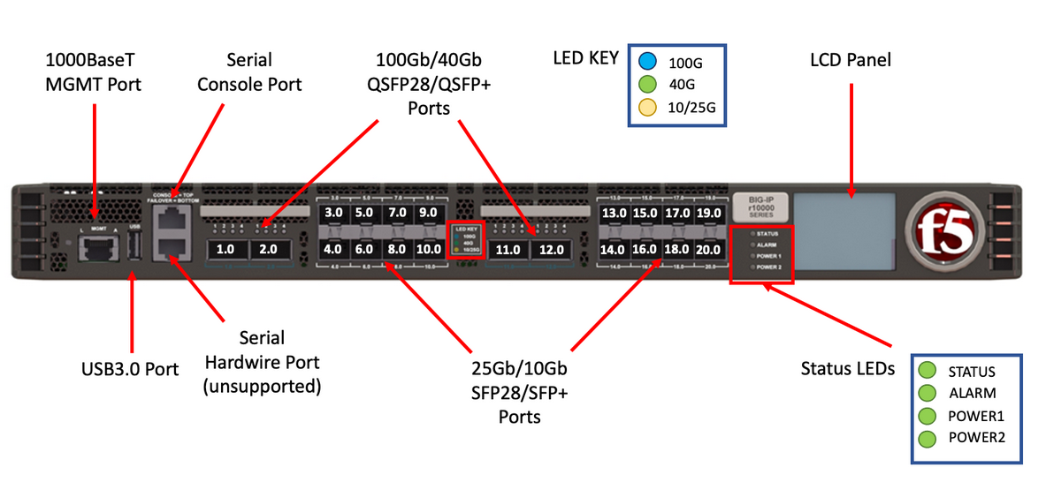
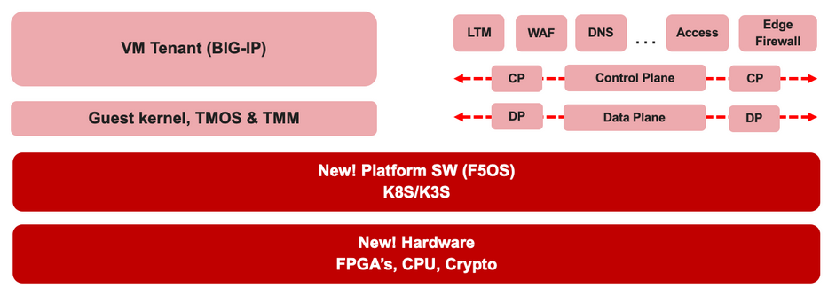

F5 rSeries Learning with
Alexander S

Slide 2
Agenda →
  iSeries to rSeries
  F5OS Basic Setup
  F5OS Upgrade Procedure
  VLAN and LAG Configuration
    Configure VLANs
    Configure LAG (Link Aggregation Group)
    Assign VLANs to the LAG
  Tenant OS Deployment Preparation
  Tenant OS Deployment
  rSeries Tenant Basic Setup
  High Availability (HA) in rSeries Tenants
    Best Practices for rSeries Tenant HA
    rSeries Tenant HA Configuration

Slide 3
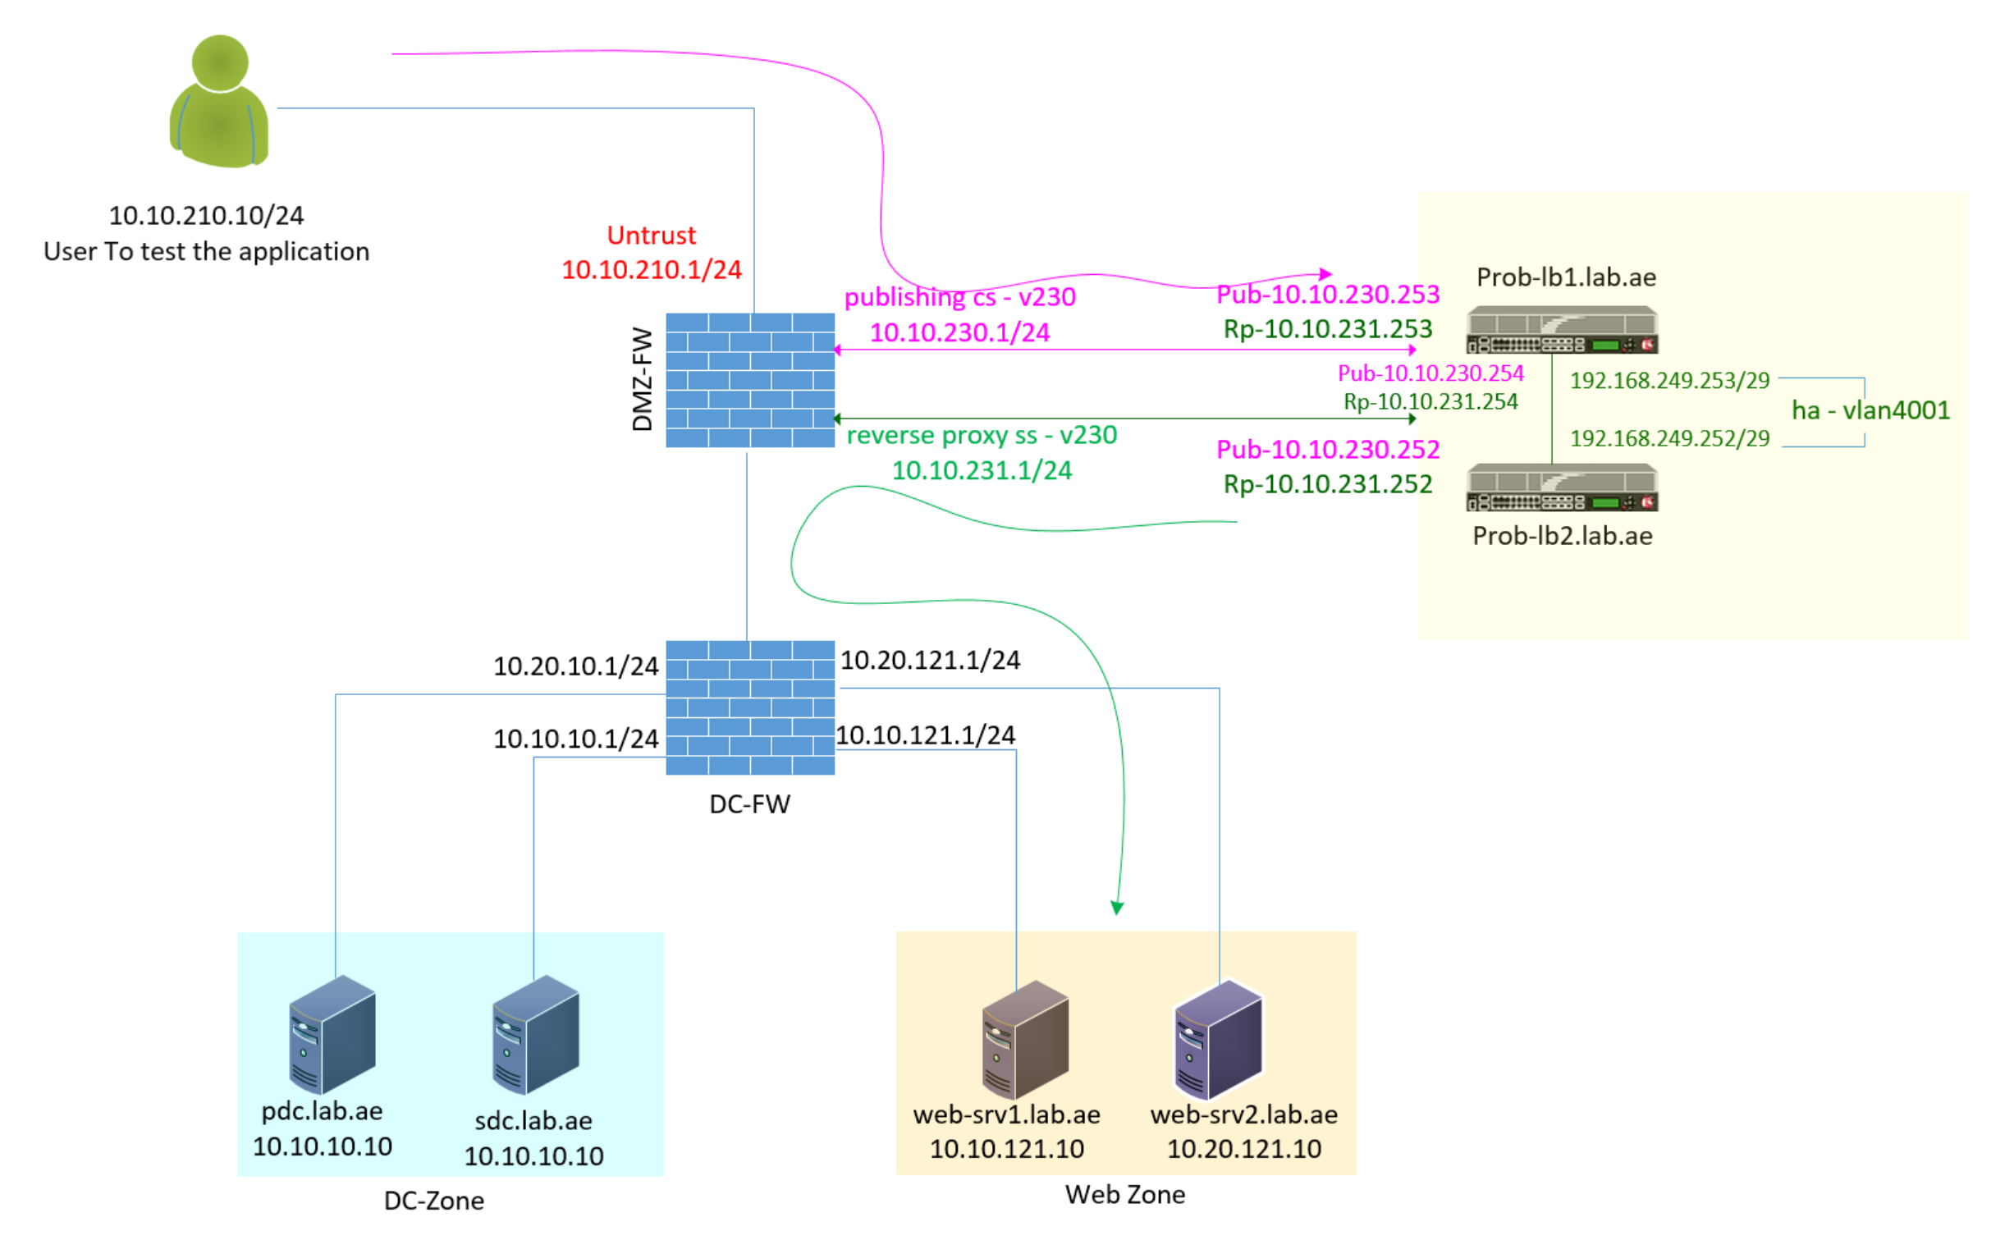
Chapter 8 – rSeries Tenant High Availability
Task 01 - Overview of rSeries High Availability (HA) Architecture
Task 02 - F5 as a Full Proxy – Let us understand the Communication Flow
Task 03 - Configure Self IP for Client-Side VLAN
Task 04 - Configure Self IP for Server-Side VLAN
Task 05 - Configure Self IP for HA VLAN
Task 06 - Configure Device Service Clustering (DSC) for High Availability
Task 07 - Validate HA Configuration Sync and Device Group Status

Slide 4
Chapter 8 – rSeries Tenant High Availability
Task 01 - Overview of rSeries High Availability (HA) Architecture
Task 02 - F5 as a Full Proxy – Let us understand the Communication Flow
Task 03 - Configure Self IP for Client-Side VLAN
Task 04 - Configure Self IP for Server-Side VLAN
Task 05 - Configure Self IP for HA VLAN
Task 06 - Configure Device Service Clustering (DSC) for High Availability
Task 07 - Validate HA Configuration Sync and Device Group Status

Slide 5
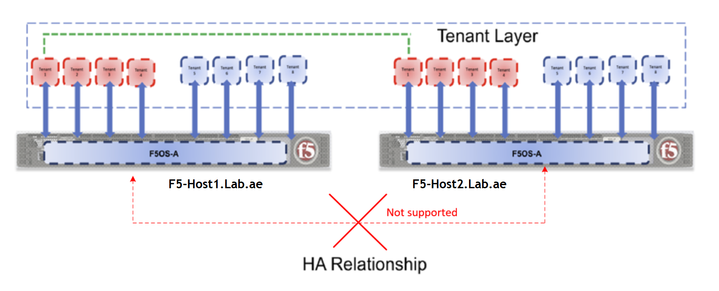
Chapter 8 – rSeries Tenant High Availability
Task 01 – Overview of rSeries High Availability (HA) Architecture
HA is not supported at the Platform Level
High Availability (HA) is not supported at the F5OS platform level.
F5OS do not exchange HA-related information with each other at the platform level
No native HA functionality between rSeries appliances at the platform (F5OS) level.

Slide 6
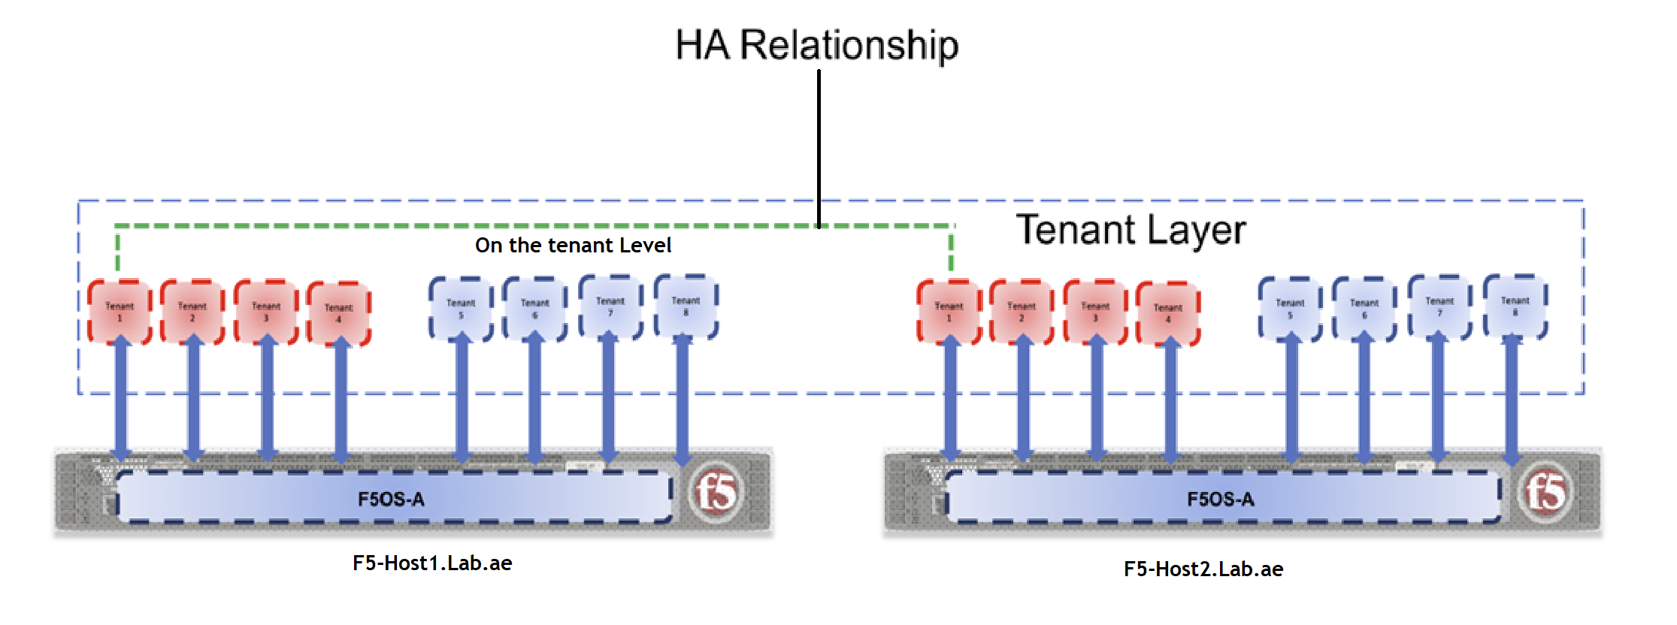
Chapter 8 – rSeries Tenant High Availability
Task 01 – Overview of rSeries High Availability (HA) Architecture
HA is supported at the tenant Level
High Availability (HA) is configured at the tenant level
BIG-IP tenant running on rSeries handles its own HA configuration.

Slide 7
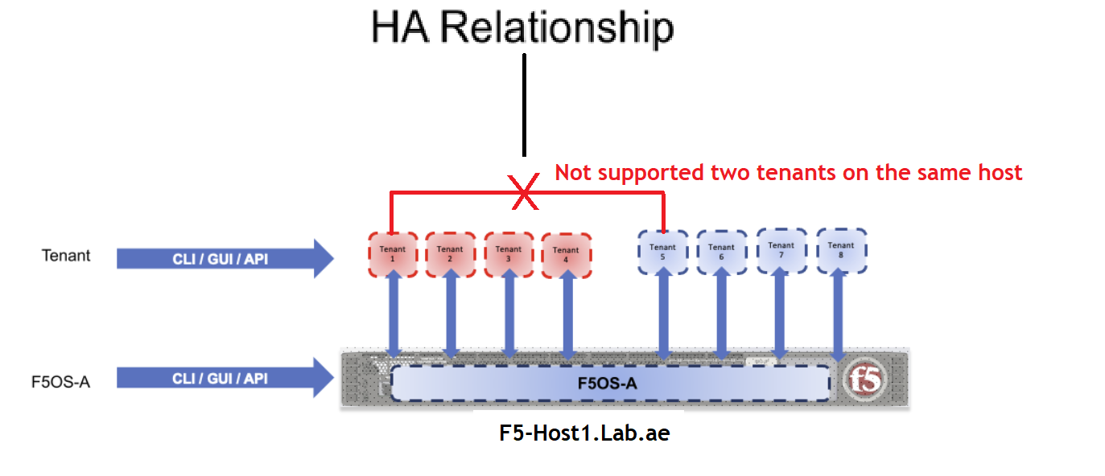
Chapter 8 – rSeries Tenant High Availability
Task 01 – Overview of rSeries High Availability (HA) Architecture
Intra-box HA is not supported
A single rSeries appliance configured with two tenants - Can we Configure HA Between these Two Tenants on the Same Appliance?
❌ No - Intra-box HA is not supported.
HA between two tenants on the same rSeries appliance is not supported.

Slide 8
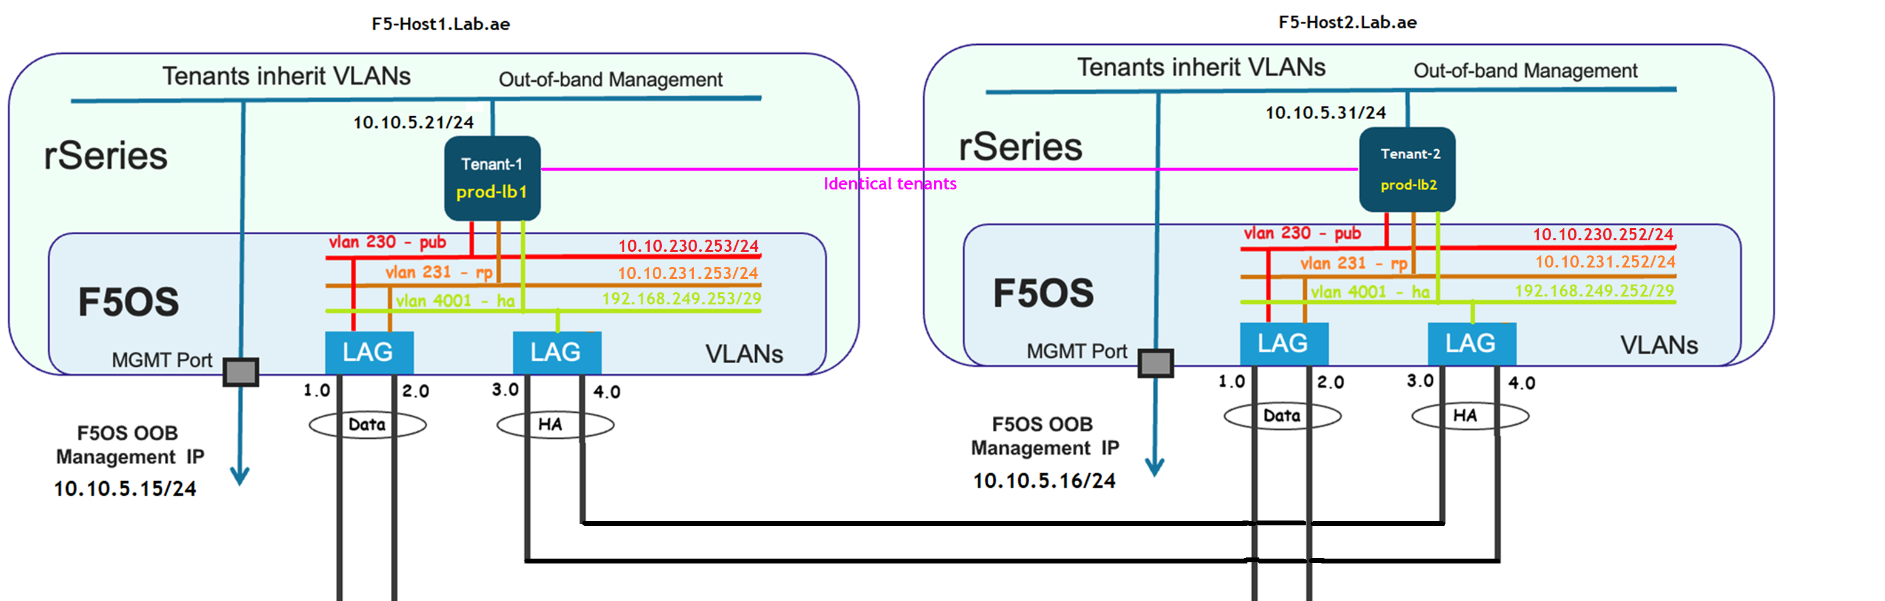
Chapter 8 – rSeries Tenant High Availability
Task 01 – Overview of rSeries High Availability (HA) Architecture
Identical tenants on two rSeries hosts
To implement HA, Need identical BIG-IP tenants on two separate rSeries appliances.
"Identical" means:
  Same number of vCPUs
  Same memory allocation
  Matching software versions
  Consistent configuration objects (Example - VLANs, self IPs and routes)

Slide 9
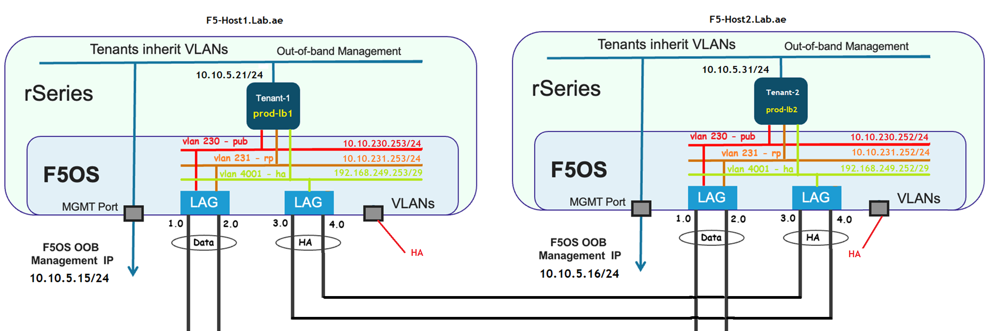
Chapter 8 – rSeries Tenant High Availability
Task 01 – Overview of rSeries High Availability (HA) Architecture
rSeries Hardware Physical HA port – Only for platform
rSeries appliances include a dedicated physical HA port.
The physical HA port is reserved at the platform (F5OS) level.
F5OS does not support native HA, it remains unused all the time in the current implementations.

Slide 10
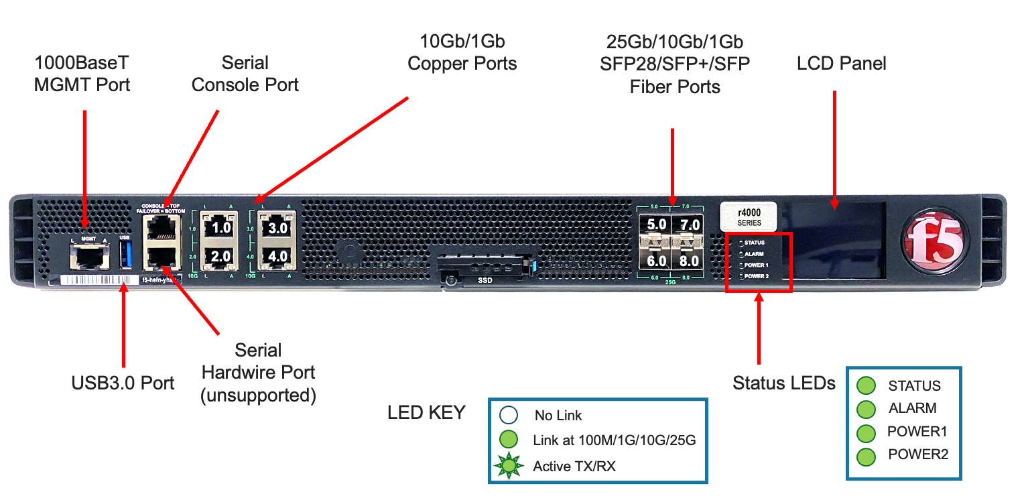
Chapter 8 – rSeries Tenant High Availability
Task 01 – Overview of rSeries High Availability (HA) Architecture
rSeries Hardware Physical HA port – Only for platform
rSeries appliances include a dedicated physical HA port.
The physical HA port is reserved at the platform (F5OS) level.
F5OS does not support native HA, it remains unused all the time in the current implementations.

Slide 11
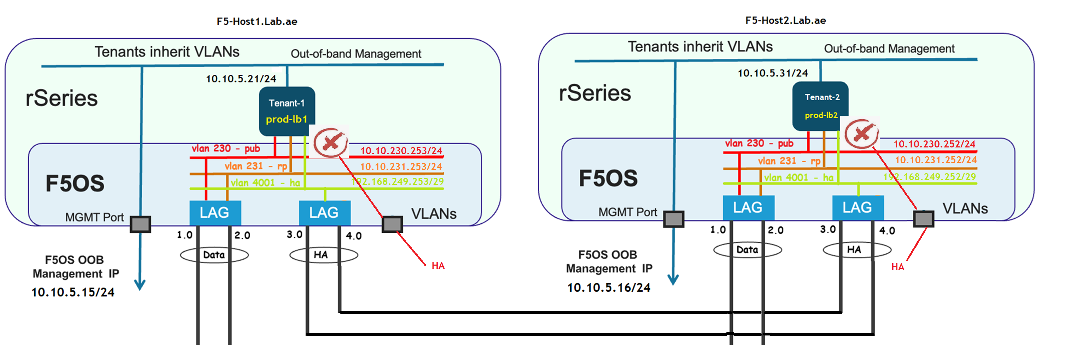
Chapter 8 – rSeries Tenant High Availability
Task 01 – Overview of rSeries High Availability (HA) Architecture
rSeries Hardware Physical HA port – Not for tenant
The physical Hardware HA port can not be used for tenant HA communication.
Tenant HA communication must be configured over data plane interfaces

Slide 12
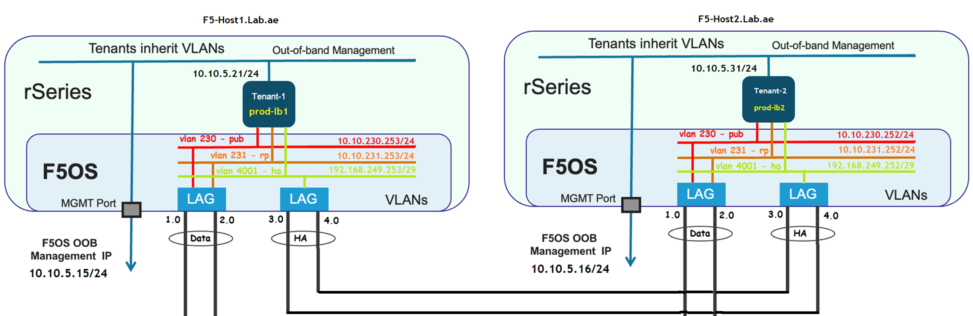
Chapter 8 – rSeries Tenant High Availability
Task 01 – Overview of rSeries High Availability (HA) Architecture
Can I Use Data Trunks for HA Traffic?
Technically, YES – But this approach is not recommended.
Mixing HA and production traffic on the same trunk can:
  Complicate troubleshooting
  Reduce the reliability and
  Reduce accuracy of HA-related health checks and failover decisions

Slide 13
Chapter 8 – rSeries Tenant High Availability
Task 01 – Overview of rSeries High Availability (HA) Architecture
Recommended HA Connectivity for tenants
Dedicated LAG (Link Aggregation Group) on each appliance specifically for HA communication.
Configure HA interconnect VLANs between the appliances over the HA LAG
It enables BIG-IP tenants to form HA relationships

Slide 14
Chapter 8 – rSeries Tenant High Availability
Task 01 – Overview of rSeries High Availability (HA) Architecture
Why a dedicated LAG?
Ensures isolation of HA sync and mirroring traffic
Improves performance and failover reliability
Provides more accurate fault detection in HA operations

Slide 15
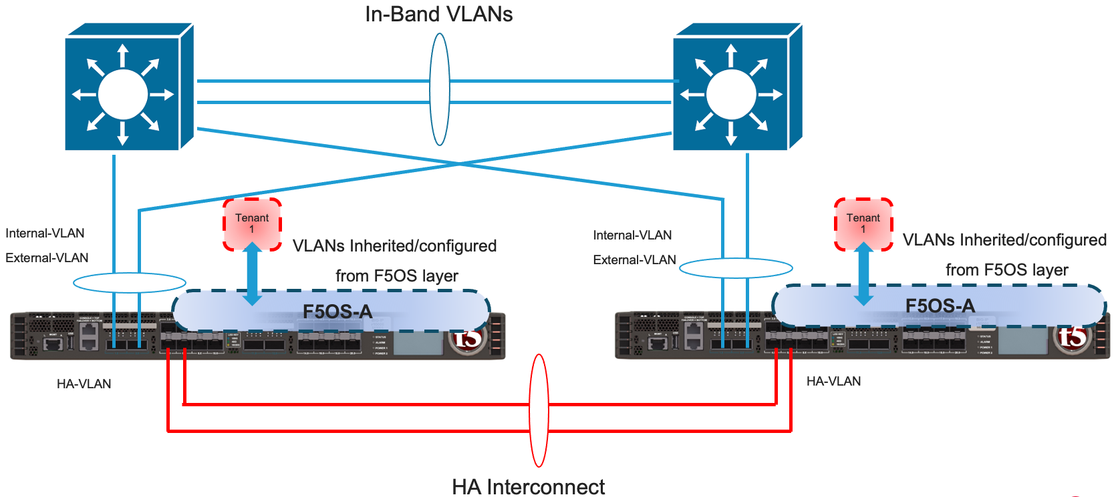
Chapter 8 – rSeries Tenant High Availability
Task 01 – Overview of rSeries High Availability (HA) Architecture
F5 Topology recommendations – Two device deployments
A direct HA LAG connection between the two appliances is ideal.
This provides low latency, simple design, and fewer points of failure.

Slide 16
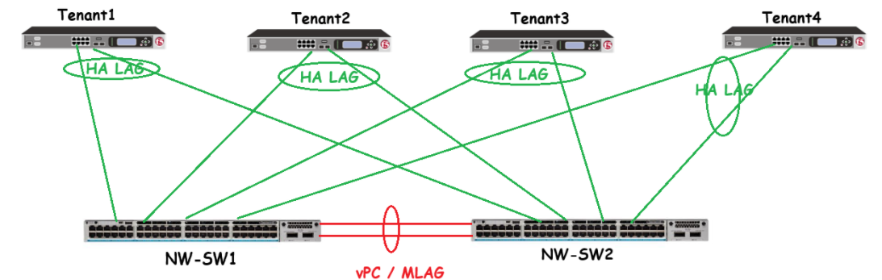
Chapter 8 – rSeries Tenant High Availability
Task 01 – Overview of rSeries High Availability (HA) Architecture
F5 Topology recommendations – Three and more devices (DSC)
With DSC you can cluster Up to 8 devices using sync-failover group and useful in larger deployments.
For three or more devices in an HA group:
  Use dual-homed LAGs connected to upstream switches that support vPC, MLAG, or similar multi-chassis link aggregation technologies.

Slide 17
Chapter 8 – rSeries Tenant High Availability
Task 01 – Overview of rSeries High Availability (HA) Architecture
F5 Topology recommendations – Three and more devices (DSC)
Scalable HA connectivity
Redundant paths
Reliable failover and sync communication across multiple appliances
Peer
Peer
Subordinate
Subordinate

Slide 18
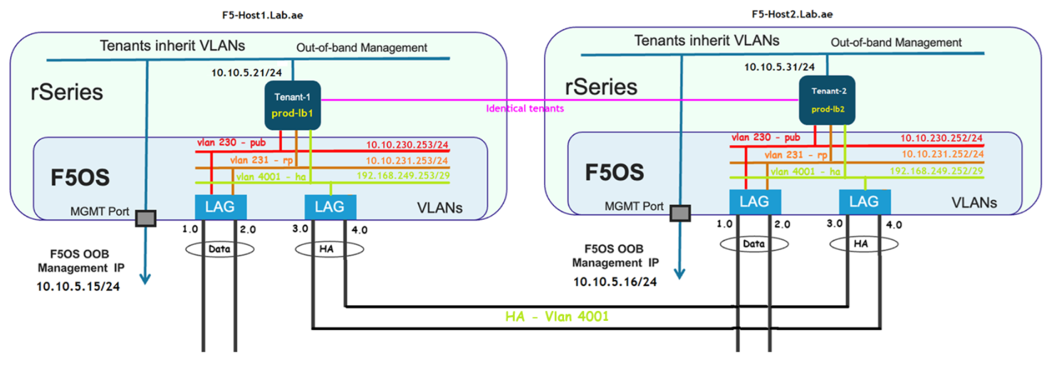
Chapter 8 – rSeries Tenant High Availability
Task 01 – Overview of rSeries High Availability (HA) Architecture
LAB Environment Topology – Two rSeries (F5OS) appliances
We have deployed two rSeries appliances with a direct HA LAG connection between them.
VLAN 4001 is configured as the HA interconnect VLAN over this LAG.
This VLAN enables tenants on both appliances to establish HA relationships

Slide 19
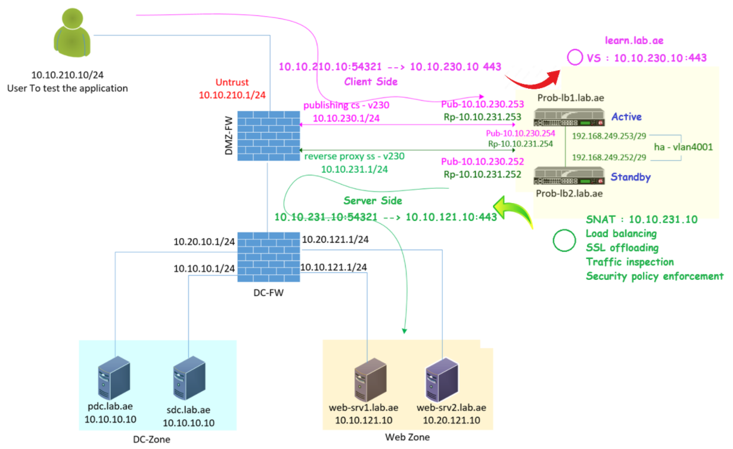
Chapter 8 – rSeries Tenant High Availability
Task 02 - F5 as a Full Proxy – Let us understand the Communication Flow
F5 Full Proxy: client side, server-side, ha self-ip and floating-ip
Prod-lb1 is currently active, with the following self IPs:
  Client-side: 10.10.230.253 (pub)
  Server-side: 10.10.231.253 (rp)
Prod-lb2 is also active, with self IPs:
  Client-side: 10.10.230.252 (pub)
  Server-side: 10.10.231.252 (rp)
The HA (high availability) IPs are:
  Prod-lb1 HA IP: 192.168.249.253
  Prod-lb2 HA IP: 192.168.249.252
Floating IPs are configured for both networks:
  Client-side floating IP: 10.10.230.254 (pub)
  Server-side floating IP: 10.10.231.254 (rp)
These floating IPs move between the devices depending on which unit is currently active.

Slide 20
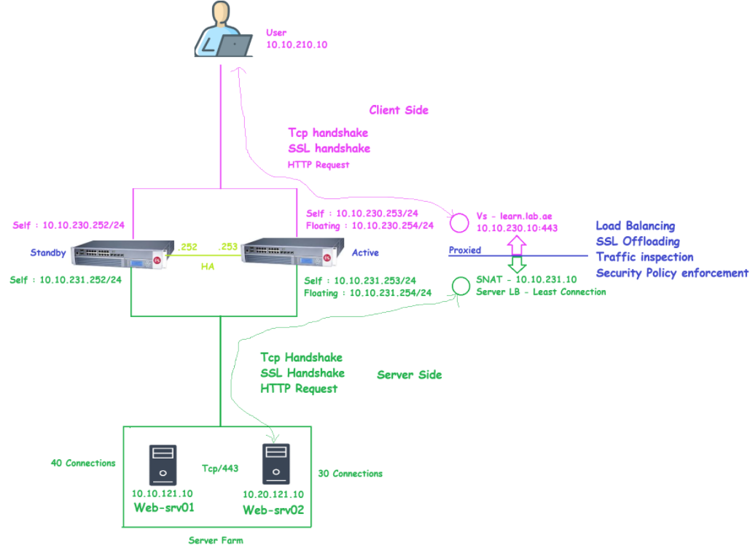
Chapter 8 – rSeries Tenant High Availability
Task 02 - F5 as a Full Proxy – Let us understand the Communication Flow
F5 Full Proxy: Connection and session handling
F5 BIG-IP device creates and manages two separate connections:
  Client-side connection: Between the client and the F5 device
  Server-side connection: Between the F5 device and the backend server
It receives the HTTP request from the client on the client-side VLAN
Based on Server Load Balancing (SLB) decisions, the F5 initiates a new, independent connection to the selected backend server.

Slide 21
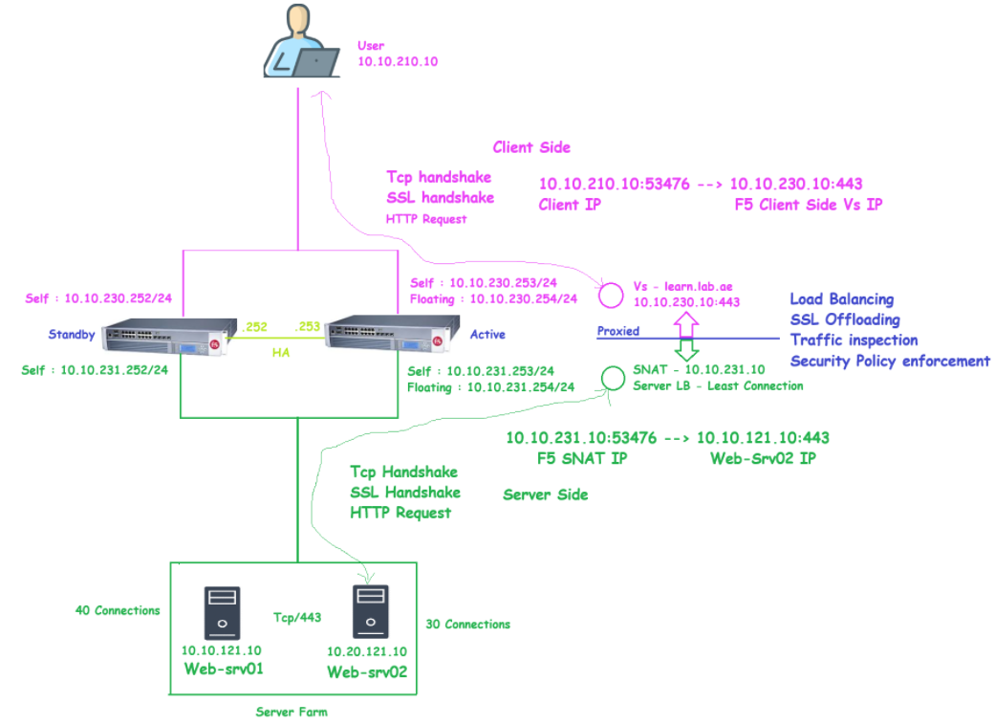
Chapter 8 – rSeries Tenant High Availability
Task 02 - F5 as a Full Proxy – Let us understand the Communication Flow
F5 Full Proxy: SNAT and Server Load Balancing
Server-Side Flow
10.10.231.10:53476 → 10.20.121.10:443
F5-SNAT-IP Web-Srv02-IP
The server is selected based on the load balancing algorithm.
In this case, the Least Connections algorithm is used, and web-srv02 is chosen because it has fewer active connections than web-srv01.

Slide 22
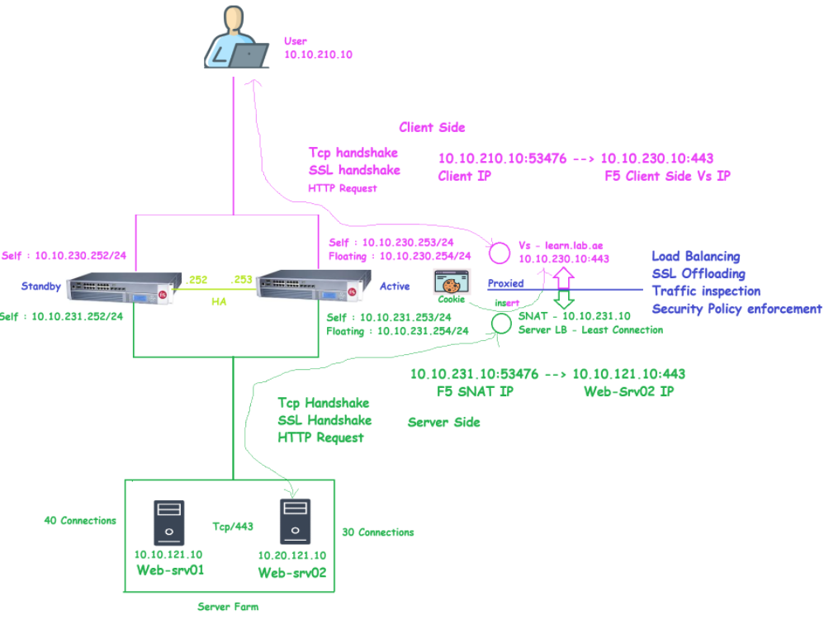
Chapter 8 – rSeries Tenant High Availability
Task 02 - F5 as a Full Proxy – Let us understand the Communication Flow
F5 Full Proxy: Modify the web server response to insert the F5 cookie
Web server respond to F5 SNAT IP
F5 creates and insert the web-cookie on the server response.

Slide 23
Chapter 8 – rSeries Tenant High Availability
Task 02 - F5 as a Full Proxy – Let us understand the Communication Flow
F5 Full Proxy: SSL Bridging
Connection from Client to F5 is over SSL
Connection from F5 to backend server also over SSL
This we call it as SSL bridging.
Here F5 can decrypt and re-encrypt the traffic for security inspection and modification

Slide 24
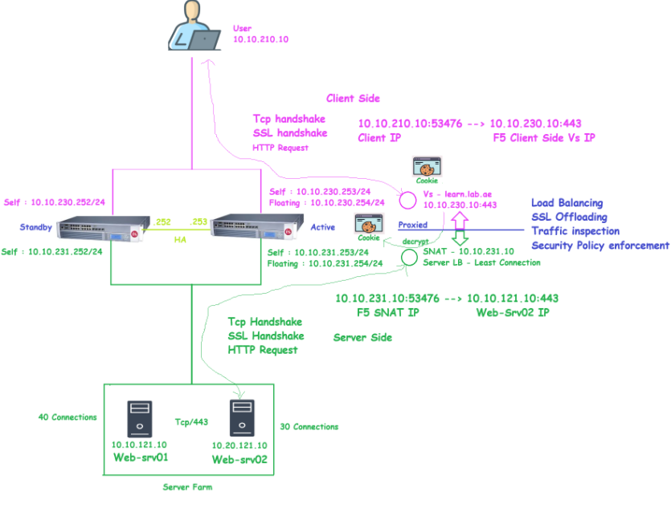
Chapter 8 – rSeries Tenant High Availability
Task 02 - F5 as a Full Proxy – Let us understand the Communication Flow
F5 Full Proxy: Session Persistence
If the client request contains cookie inserted by F5
F5 verify and decrypts the cookie
Inside the cookie Web-Server information stored
F5 read the cookie and identify the web server who served the request for this client
It forward this request to the same server

Slide 25
Chapter 8 – rSeries Tenant High Availability
Task 02 - F5 as a Full Proxy – Let us understand the Communication Flow
F5 Full Proxy: Key benefits of Full Proxy
Key Benefit : it optimize and control the traffic
  Load balancing
  SSL offloading
  Traffic inspection & Security policy enforcement

Slide 26
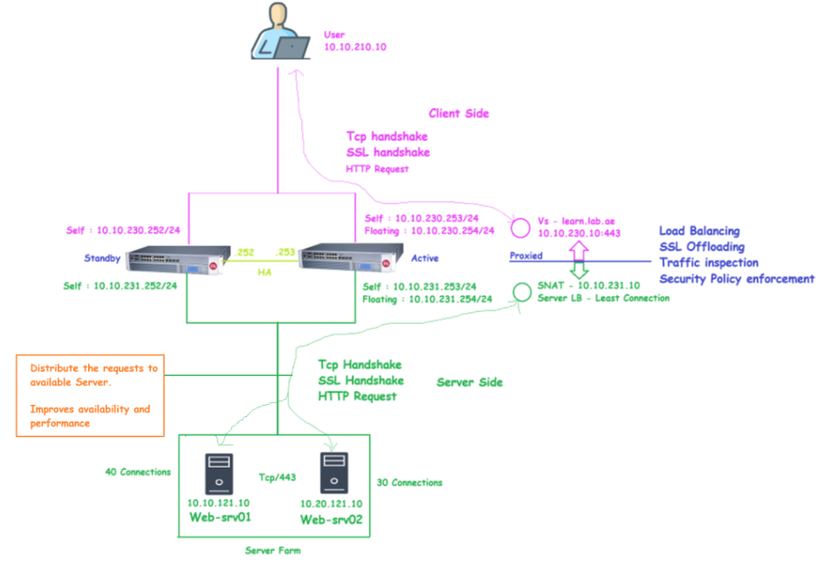
Chapter 8 – rSeries Tenant High Availability
Task 02 - F5 as a Full Proxy – Let us understand the Communication Flow
F5 Full Proxy: Key benefits of Full Proxy – Server Load Balancing
Server Load Balancing
  When multiple backend servers are available, F5 can distribute incoming requests across them based on various load balancing algorithms (like round-robin, least connections, etc.).
  This helps in optimizing resource usage and improving application availability and scalability.

Slide 27
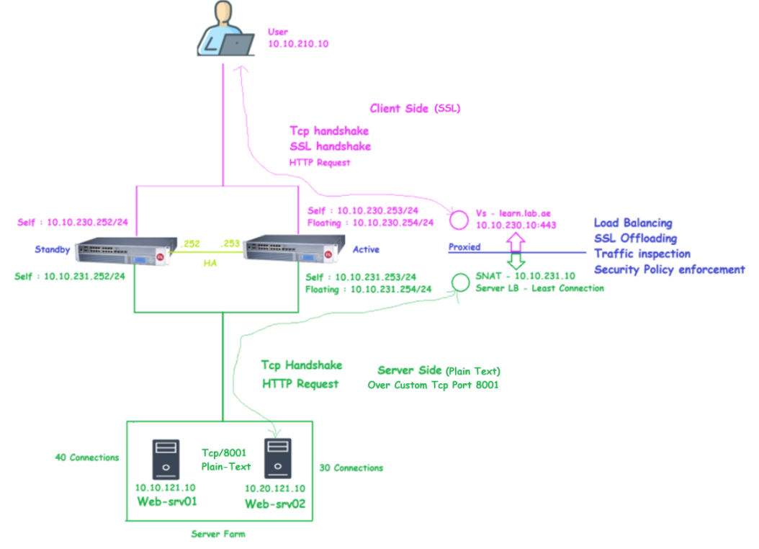
Chapter 8 – rSeries Tenant High Availability
Task 02 - F5 as a Full Proxy – Let us understand the Communication Flow
F5 Full Proxy: Key benefits of Full Proxy – SSL Offloading
SSL Offloading
  Consider a scenario where the backend web application is running on a custom port without SSL.
  Even though F5 receives the client-side connection over SSL, it can terminate the SSL at F5 and forward the request to the backend server in plain text using the custom port.
  In this case, the client-to-F5 connection is encrypted (SSL), but the F5-to-server connection is unencrypted (HTTP).
  This is called SSL Offloading. It offloads the SSL processing burden from the backend servers to the F5 device.

Slide 28
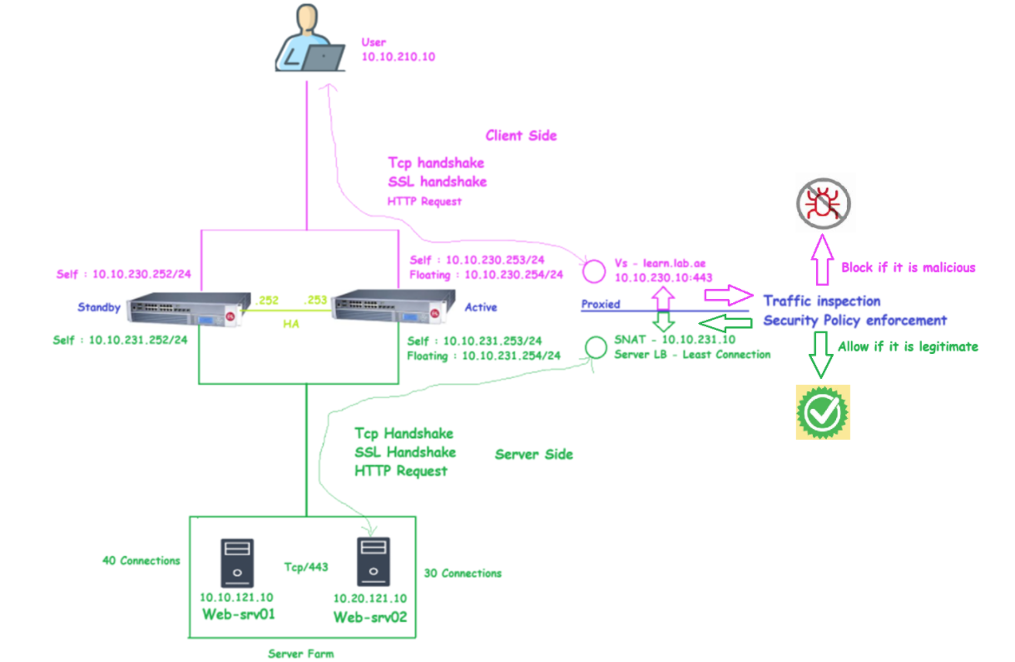
Chapter 8 – rSeries Tenant High Availability
Task 02 - F5 as a Full Proxy – Let us understand the Communication Flow
F5 Full Proxy: Key benefits of Full Proxy – Traffic Inspection & Security Policy Enforcement
Traffic Inspection & Security Policy Enforcement
  A key advantage of F5's full proxy architecture is its ability to inspect incoming HTTP/HTTPS traffic.
  Once the F5 receives the request, it can evaluate it against security policies, and if deemed safe, initiate a new server-side connection on behalf of the client.
  This means malicious traffic can be identified and dropped at the F5 itself, without ever reaching the backend server.
  This helps in protecting backend systems from attacks such as SQL injection, XSS, or protocol-based exploits.

Slide 29
Chapter 8 – rSeries Tenant High Availability
Task 03 – Configure Self IP and Assign it to the Client-Side VLAN
Client-side interface is used for the application publishing
The client-side interface is configured for the application publishing, where the clients connect to F5.

Slide 30
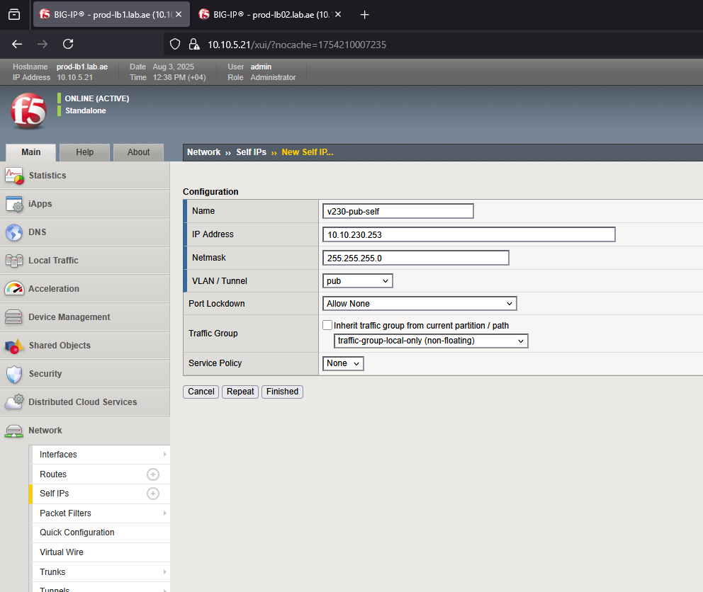
Chapter 8 – rSeries Tenant High Availability
Task 03 – Configure Self IP and Assign it to the Client-Side VLAN
Configure the client-side Self IP in prod-lb1
Navigate to Network → Self IPs → Create
Set the Name to: v230-pub-self.
Set the IP Address to: 10.10.230.253.
Set the Netmask to: 255.255.255.0.
Under VLAN/Tunnel, select: pub (which corresponds to VLAN 230).
Set the port lockdown mode is set to Allow-None
Set the Traffic Group to: traffic-group-local-only

Slide 31
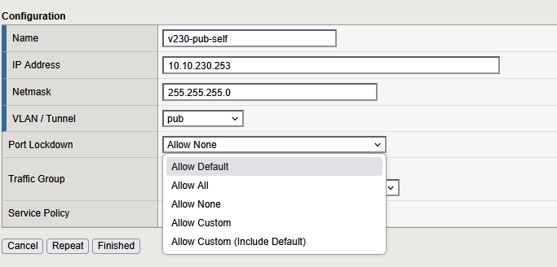
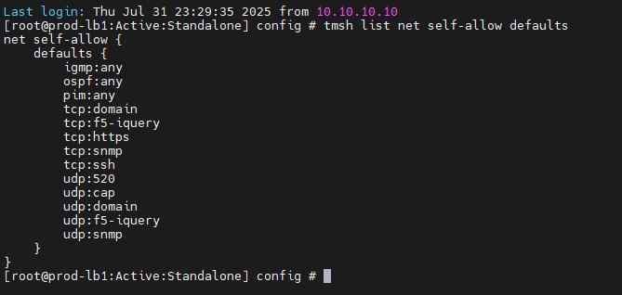
Chapter 8 – rSeries Tenant High Availability
Task 03 – Configure Self IP and Assign it to the Client-Side VLAN
Configure the client-side Self IP in prod-lb1– Understand the Port lock-down
Port Lockdown setting controls what kind of traffic is allowed.
There are five options available for you to choose:
Allow None is the most restrictive option. It allows only essential network communication like ARP and ICMP ping and blocks all other incoming connections to the Self IP.
Allow Default is the F5-recommended Port Lockdown setting for Self IPs.
  Let us see what is Allow Default. You can verify what is allowed using the command "tmsh list net self-allow defaults"
    https
    iquery
    ssh
    igmp and ospf
    pim and snmp
  Allow-Default provides a balance between security and functionality, allowing required F5-to-F5 and F5-to-network communication, while blocking unnecessary access.

Slide 32
Chapter 8 – rSeries Tenant High Availability
Task 03 – Configure Self IP and Assign it to the Client-Side VLAN
Configure the client-side Self IP in prod-lb1– Understand the Port lock-down
Allow Custom gives you full control to specify exactly which ports and protocols should be allowed.
Allow Custom + Include Default is a more balanced and secure option. It allows the custom ports you define, while also automatically including the necessary internal service ports that F5 uses for its system functions.
Allow All is the least restrictive mode. It permits all incoming traffic to the Self IP. This mode is generally not recommended in production environments due to security risks unless necessary.

Slide 33
Chapter 8 – rSeries Tenant High Availability
Task 03 – Configure Self IP and Assign it to the Client-Side VLAN
Configure the client-side Self IP in prod-lb1– Self IP act as a gateway for Vlan
The Self IP(10.10.230.253 & 10.10.230.252) assigned to the client-side publishing VLAN interface acts as a gateway to reach the virtual servers.

Slide 34
Chapter 8 – rSeries Tenant High Availability
Task 03 – Configure Self IP and Assign it to the Client-Side VLAN
Configure the client-side Self IP in prod-lb1
Navigate to Network → Self IPs → Create
Set the Name to: v230-pub-self.
Set the IP Address to: 10.10.230.253.
Set the Netmask to: 255.255.255.0.
Under VLAN/Tunnel, select: pub (which corresponds to VLAN 230).
Set the port lockdown mode is set to Allow-None
Set the Traffic Group to: traffic-group-local-only

Slide 35
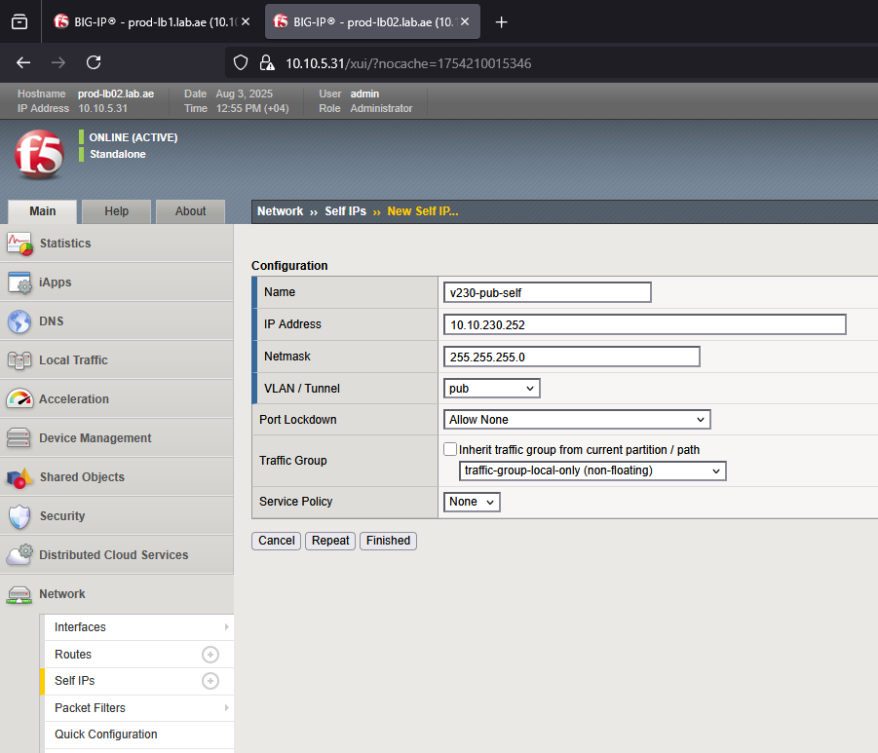
Chapter 8 – rSeries Tenant High Availability
Task 03 – Configure Self IP and Assign it to the Client-Side VLAN
Configure the client-side Self IP in prod-lb2
Navigate to Network → Self IPs → Create
Set the Name to: v230-pub-self.
Set the IP Address to: 10.10.230.252.
Set the Netmask to: 255.255.255.0.
Under VLAN/Tunnel, select: pub (which corresponds to VLAN 230).
Set the port lockdown mode is set to Allow-None
Set the Traffic Group to: traffic-group-local-only

Slide 36
Chapter 8 – rSeries Tenant High Availability
Task 03 – Configure Self IP and Assign it to the Client-Side VLAN
We successfully configured the client side self ip’s in
prod-lb1(10.10.230.253) and
prod-lb2(10.10.230.252)

Slide 37
Chapter 8 – rSeries Tenant High Availability
Task 04 – Configure Self IP and Assign it to the Server-Side VLAN
Server-Side interface is used for the Reverse Proxy
The Server-Side vlan interface is used by F5 to connect to backend servers when acting as a reverse proxy.

Slide 38
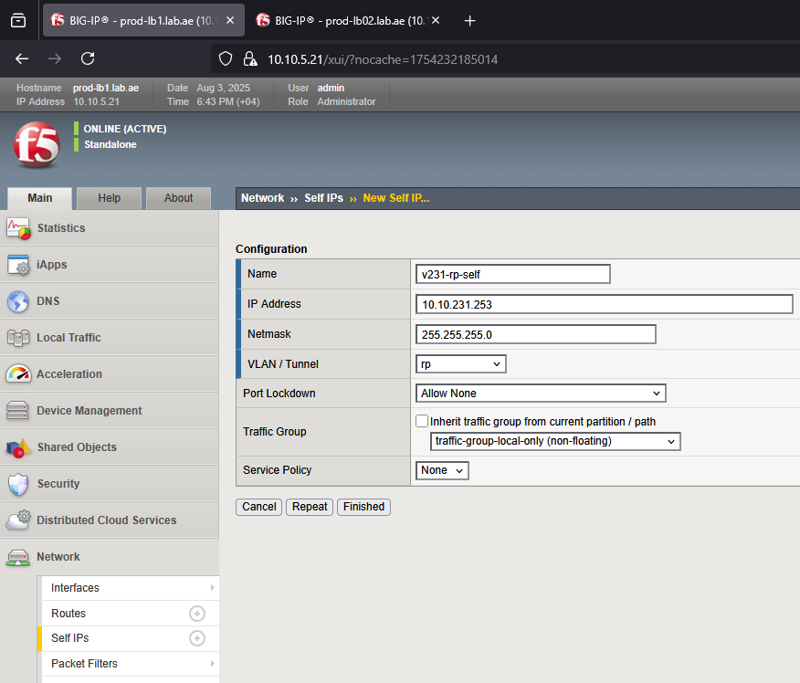
Chapter 8 – rSeries Tenant High Availability
Task 04 – Configure Self IP and Assign it to the Client-Side VLAN
Configure the Server-side Self IP in prod-lb1
Navigate to Network → Self IPs → Create
Set the Name to : v231-rp-self.
Set the IP Address to : 10.10.231.253.
Set the Netmask to : 255.255.255.0.
Under VLAN/Tunnel, select : rp (which corresponds to VLAN 231).
Set the port lockdown mode is set to : Allow-None
Set the Traffic Group to : traffic-group-local-only

Slide 39
Chapter 8 – rSeries Tenant High Availability
Task 04 – Configure Self IP and Assign it to the Server-Side VLAN
Configure the Server-Side Self IP – This act as a gateway for Server-Side Vlan
The Self IP(10.10.231.253 & 10.10.231.252) assigned to the server-side reverse-proxy VLAN interface acts as a gateway to reach the SNAT ip addresses.

Slide 40
Chapter 8 – rSeries Tenant High Availability
Task 04 – Configure Self IP and Assign it to the Client-Side VLAN
Configure the Server-side Self IP in prod-lb1
Navigate to Network → Self IPs → Create
Set the Name to : v231-rp-self.
Set the IP Address to : 10.10.231.253.
Set the Netmask to : 255.255.255.0.
Under VLAN/Tunnel, select : rp (which corresponds to VLAN 231).
Set the port lockdown mode is set to : Allow-None
Set the Traffic Group to : traffic-group-local-only

Slide 41
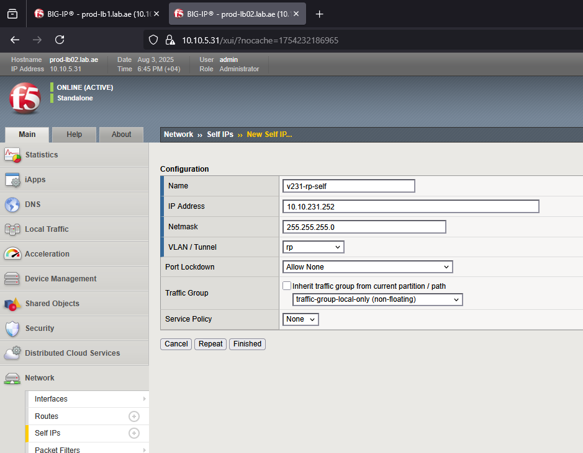
Chapter 8 – rSeries Tenant High Availability
Task 04 – Configure Self IP and Assign it to the Client-Side VLAN
Configure the Server-side Self IP in prod-lb2
Navigate to Network → Self IPs → Create
Set the Name to : v231-rp-self.
Set the IP Address to : 10.10.231.252.
Set the Netmask to : 255.255.255.0.
Under VLAN/Tunnel, select : rp (which corresponds to VLAN 231).
Set the port lockdown mode is set to : Allow-None
Set the Traffic Group to : traffic-group-local-only

Slide 42
Chapter 8 – rSeries Tenant High Availability
Task 04 – Configure Self IP and Assign it to the Server-Side VLAN
We successfully configured the server side self ip’s in
prod-lb1(10.10.231.253) and
prod-lb2(10.10.231.252)

Slide 43
Chapter 8 – rSeries Tenant High Availability
Task 05 – Configure Self IP and Assign it to the HA VLAN
HA Interfaces enable peer to peer communication
HA interface enables peer-to-peer communication between the F5 devices for failover and sync.

Slide 44
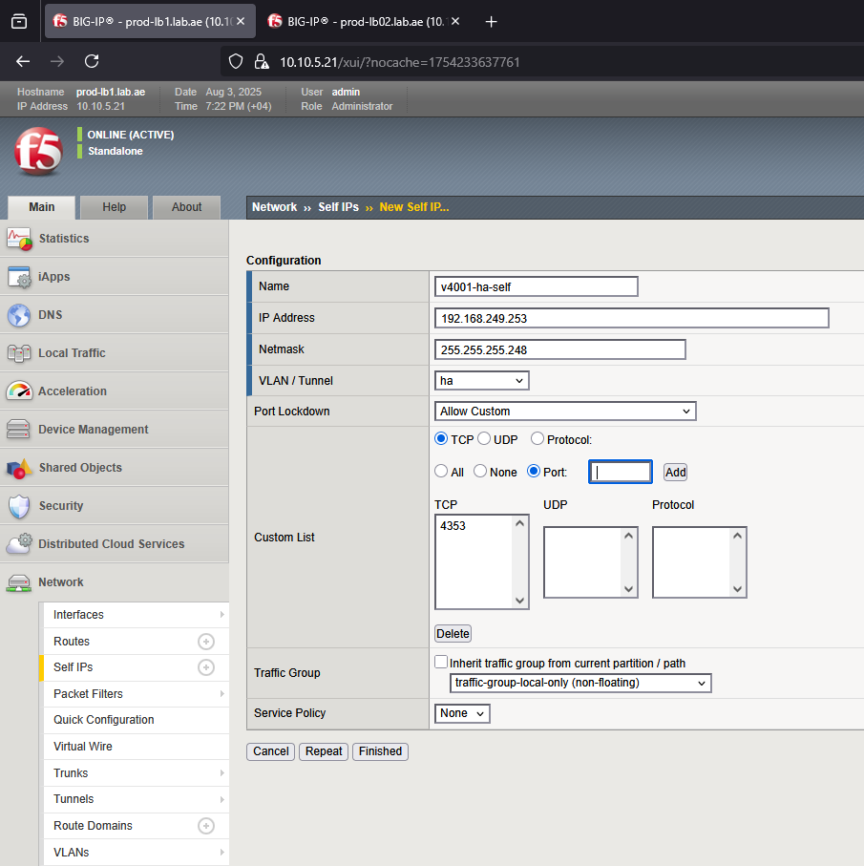
Chapter 8 – rSeries Tenant High Availability
Task 05 – Configure Self IP and Assign it to the HA VLAN
Configure the HA Self IP in prod-lb1
Navigate to Network → Self IPs → Create
Set the Name to : v4001-ha-self
Set the IP Address to : 192.168.249.253
Set the Netmask to : 255.255.255.248
Under VLAN/Tunnel, select : ha (which corresponds to VLAN 4001)
Note:
  Allow-Default is F5 recommended port lock-down setting for HA
  We will not use this here. We will use Allow-Custom
Set the port lockdown mode is set to : Allow-Custom
tcp:4353 – config sync
udp:1026 – network failover hear beats (do not allow)
(It creates split brain)
Set the Traffic Group to : traffic-group-local-only

Slide 45
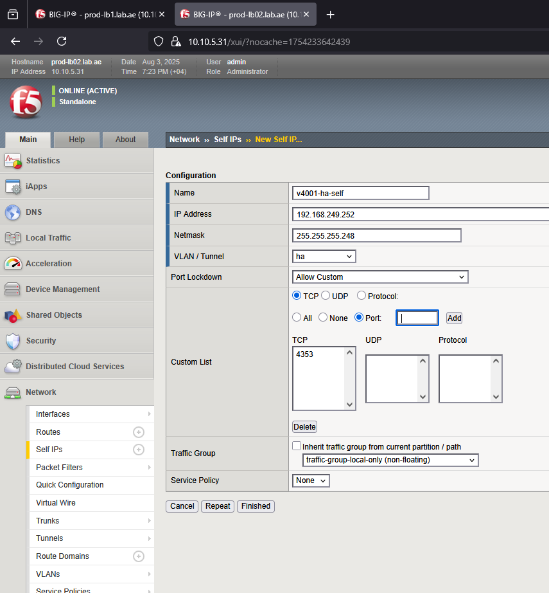
Chapter 8 – rSeries Tenant High Availability
Task 05 – Configure Self IP and Assign it to the HA VLAN
Configure the HA Self IP in prod-lb2
Navigate to Network → Self IPs → Create
Set the Name to : v4001-ha-self
Set the IP Address to : 192.168.249.252
Set the Netmask to : 255.255.255.248
Under VLAN/Tunnel, select : ha (which corresponds to VLAN 4001)
Set the port lockdown mode is set to : Allow-Custom
tcp:4353 – config sync
udp:1026 – network failover hear beats (do not allow)
(It creates split brain)
Set the Traffic Group to : traffic-group-local-only

Slide 46
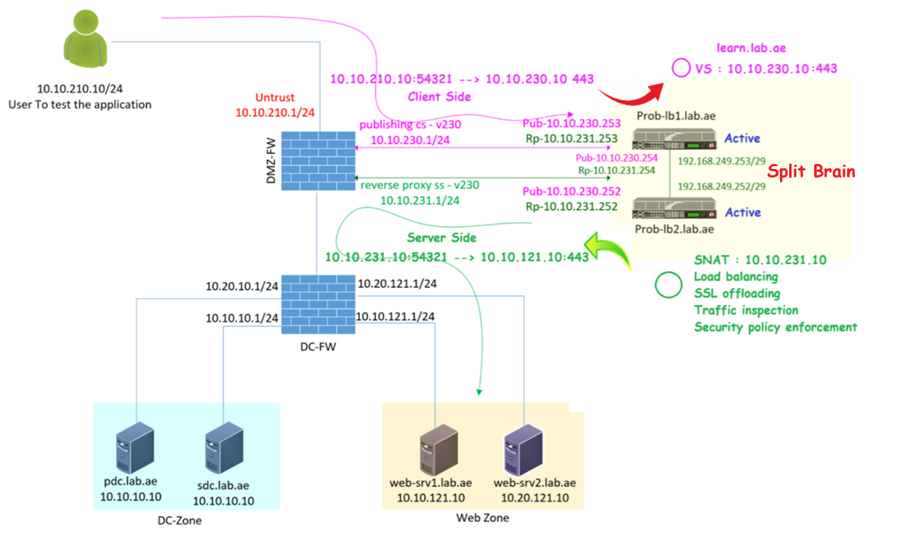
Chapter 8 – rSeries Tenant High Availability
Task 05 – Configure Self IP and Assign it to the HA VLAN (Split brain)
Navigate to Network → Self IPs → Create
Set the Name to : v4001-ha-self
Set the IP Address to : 192.168.249.252
Set the Netmask to : 255.255.255.248
Under VLAN/Tunnel, select : ha (which corresponds to VLAN 4001)
Set the port lockdown mode is set to : Allow-Custom
tcp:4353 – config sync
udp:1026 – network failover hear beats (do not allow)
(It creates split brain)
Set the Traffic Group to : traffic-group-local-only

Slide 47
Chapter 8 – rSeries Tenant High Availability
Task 05 – Configure Self IP and Assign it to the HA VLAN
We successfully configured the HA self ip’s in
prod-lb1(192.168.249.253) and
prod-lb2(192.168.249.252)

Slide 48
Chapter 8 – rSeries Tenant High Availability
Task 06 – F5 Device Service Clustering (DSC)
Device Service Clustering (DSC) is for F5 high availability (HA) and scalability framework.
This allows up to 8 BIG-IP devices to work together in a single sync-failover group.
Device Service Clustering (DSC)

Slide 49
Chapter 8 – rSeries Tenant High Availability
Task 06 – F5 Device Service Clustering (DSC)
Section 01 - Let us understand Core Features of F5 DSC
Section 02 - Let us verify DSC prerequisites
Section 02 - Let us configure the DSC

Slide 50
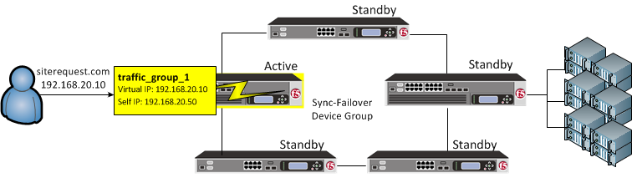
Chapter 8 – rSeries Tenant High Availability
Task 06 - F5 Device Service Clustering (DSC)
Section 01 - Let us understand Core Features of F5 DSC
Device Groups
Traffic Groups
Configuration Sync
Failover mechanisms

Slide 51
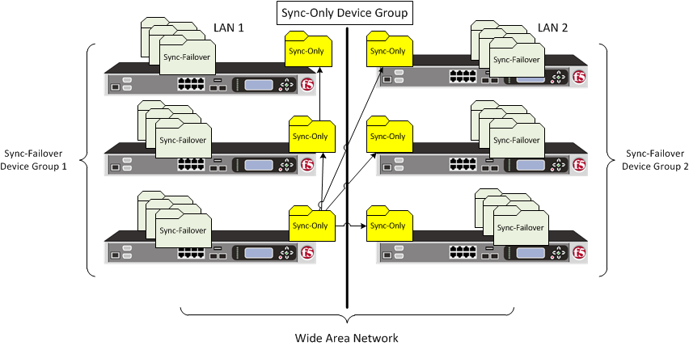
Chapter 8 – rSeries Tenant High Availability
Task 06 - F5 Device Service Clustering (DSC)
Section 01 - Let us understand Core Features of F5 DSC - Type of Device Groups
Devices are grouped into Device Groups to enable high availability and configuration synchronization between BIG-IP systems.
Types of Device groups
  Sync-Only
  Sync-Failover Group

Slide 52
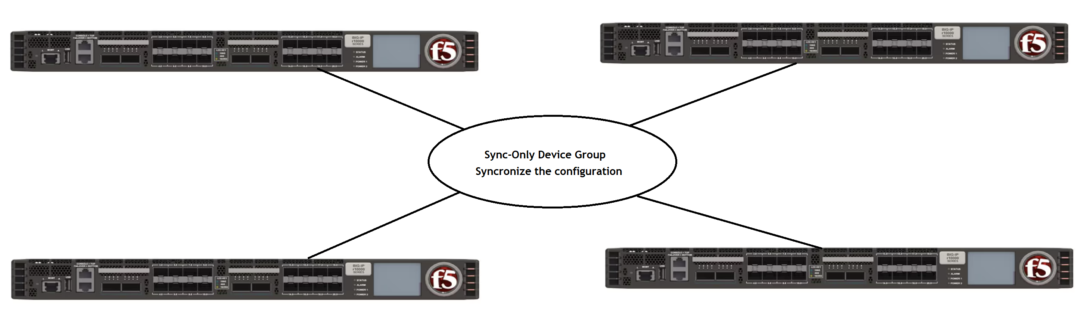
Chapter 8 – rSeries Tenant High Availability
Task 06 - F5 Device Service Clustering (DSC)
Section 01 - Let us understand Core Features of F5 DSC - Sync-Only Device Group
Sync-Only Device Group – Used only for configuration synchronization between devices. It does not support failover.

Slide 53
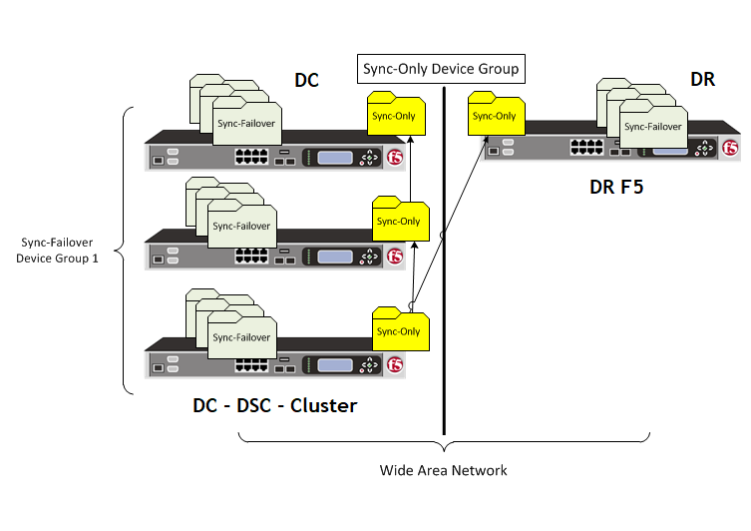
Chapter 8 – rSeries Tenant High Availability
Task 06 - F5 Device Service Clustering (DSC)
Section 01 - Let us understand Core Features of F5 DSC - Sync-Only Device Group – Use Cases
One of my friend called me regarding building a Disaster Recovery (DR) F5 and syncing the configuration from the existing Data Center (DC) F5 cluster.
His plan was to create a Sync-Only device group to synchronize Virtual Servers, Pools, and Floating IPs. He reached out just to confirm whether this approach is valid.
Is this approach is valid?

Slide 54
Chapter 8 – rSeries Tenant High Availability
Task 06 - F5 Device Service Clustering (DSC)
Section 01 - Let us understand Core Features of F5 DSC - Sync-Only Device Group – Only sync non-traffic objects
Not at all. Sync-only groups do not sync traffic-related objects. This is by design - they only synchronize non-traffic objects.
Okay, what are traffic and non-traffic objects?
Traffic objects are involved in routing and traffic handling, such as:
  Virtual Servers
  Pools / Nodes
  Floating IPs
  Routes
Non-traffic objects are not directly involved in routing and traffic handling, such as:
  Partitions
  Policies (WAF, APM)
  iRules, profiles
  SSL certs
In summary:
  If you create a Sync-Only group, it will only sync non-traffic objects like APM and ASM policies. It will not sync Virtual Servers, Pools, or Floating IPs.

Slide 55
Chapter 8 – rSeries Tenant High Availability
Task 06 - F5 Device Service Clustering (DSC)
Section 01 - Let us understand Core Features of F5 DSC - Sync-Only Failover Group
Supports both configuration synchronization and automatic failover of traffic groups between devices in the event of a device or link failure.

Slide 56
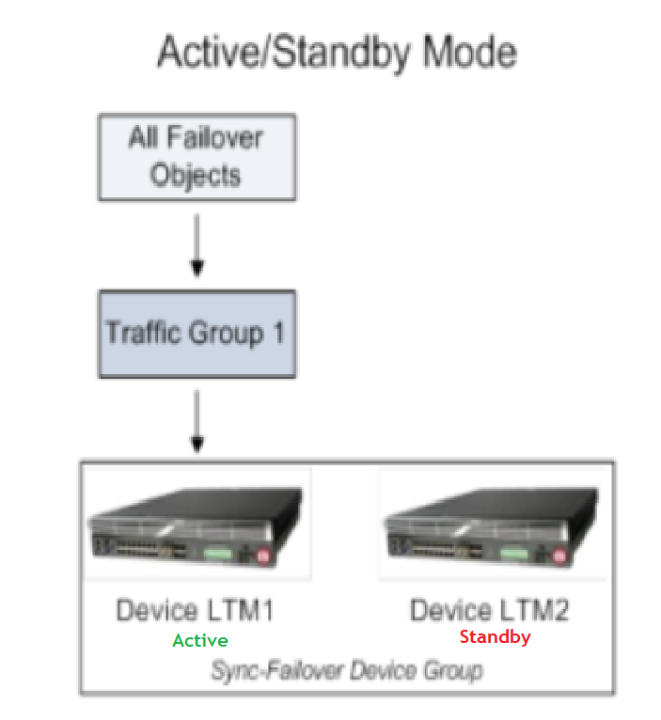
Chapter 8 – rSeries Tenant High Availability
Task 06 - F5 Device Service Clustering (DSC)
Section 01 - Let us understand Core Features of F5 DSC - Traffic Group – Active/Standby
Traffic Group are Logical containers for failover configuration objects (e.g., virtual servers, floating-self Ips and routes).
By default, F5 uses traffic-group-1 for active/standby setups - this traffic group is active on one unit and standby on the other.

Slide 57
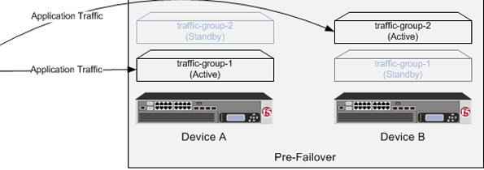
Chapter 8 – rSeries Tenant High Availability
Task 06 - F5 Device Service Clustering (DSC)
Section 01 - Let us understand Core Features of F5 DSC - Traffic Group / Active-Active
In active-active deployments, you can configure multiple traffic groups (e.g., traffic-group-1 and traffic-group-2).
For example, traffic-group-1 can be active on Unit 1 and standby on Unit 2, while traffic-group-2 is active on Unit 2 and standby on Unit 1. This setup allows both devices to actively process traffic simultaneously.

Slide 58
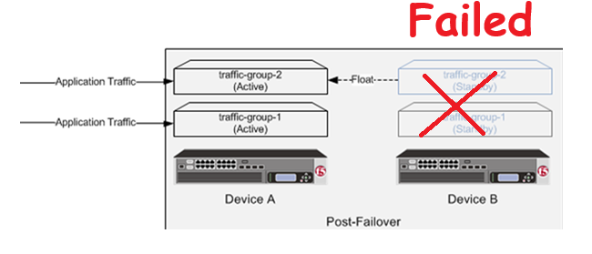
Chapter 8 – rSeries Tenant High Availability
Task 06 - F5 Device Service Clustering (DSC)
Section 01 - Let us understand Core Features of F5 DSC - Traffic Group / Active-Active
In the event of a failover, traffic groups automatically migrate to the other unit to ensure continuous service availability.
Device B Failed
Device A is active for both the traffic groups

Slide 59
Chapter 8 – rSeries Tenant High Availability
Task 06 - F5 Device Service Clustering (DSC)
Section 01 - Let us understand Core Features of F5 DSC - Traffic Group / Active-Active
Two different traffic groups create an active-active cluster for different web applications.

Slide 60
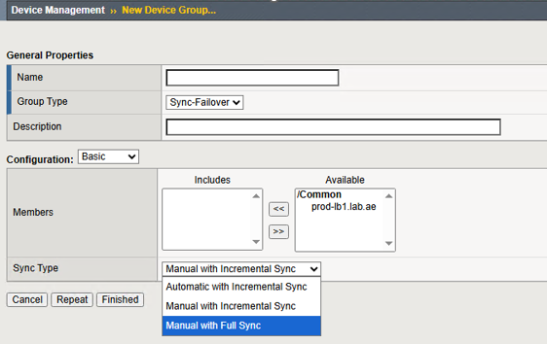
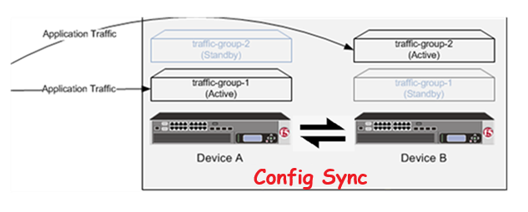
Chapter 8 – rSeries Tenant High Availability
Task 06 - F5 Device Service Clustering (DSC)
Section 01 - Let us understand Core Features of F5 DSC - Configuration Synchronization (Automatic/Manual)
Configuration Sync:
Keeps the configuration consistent across devices in the group.
Can be manual or automatic:
Manual – You must manually initiate a sync after each configuration change.
Automatic – The system automatically synchronizes configuration changes to all members in the device group.

Slide 61
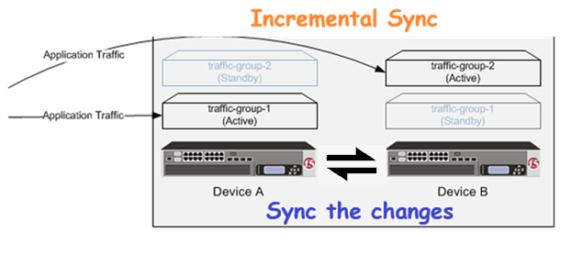
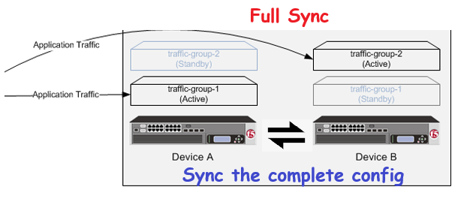
Chapter 8 – rSeries Tenant High Availability
Task 06 - F5 Device Service Clustering (DSC)
Section 01 - Let us understand Core Features of F5 DSC - Configuration Synchronization (Incremental/Full Sync)
Incremental
Only configuration changes made since the last sync are pushed.
Faster and consumes less bandwidth.
Ideal for frequent, small updates.
Keeps both devices in sync without overwriting the entire configuration.
Full Sync
Pushes the entire configuration from the source device to the peer.
Overwrites the target device’s configuration (except for device-specific settings).
Slower and resource-intensive.
Ensures full consistency between peers.

Slide 62
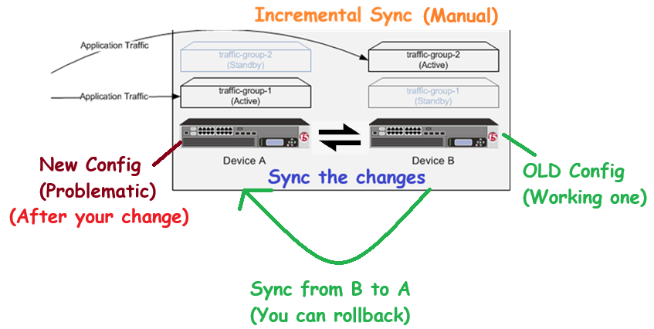
Chapter 8 – rSeries Tenant High Availability
Task 06 - F5 Device Service Clustering (DSC)
Section 01 - Let us understand Core Features of F5 DSC - Configuration Synchronization (Manual incremental sync)
I always recommend using manual-incremental sync because:
If you try to make changes to enhance the virtual server configuration and it ends up breaking the entire application and no backup exists
Then there’s no easy way to revert in F5.
However, with manual sync, you still have a recovery option:
You can sync the correct configuration from the standby device, because it still holds the older, working configuration.

Slide 63
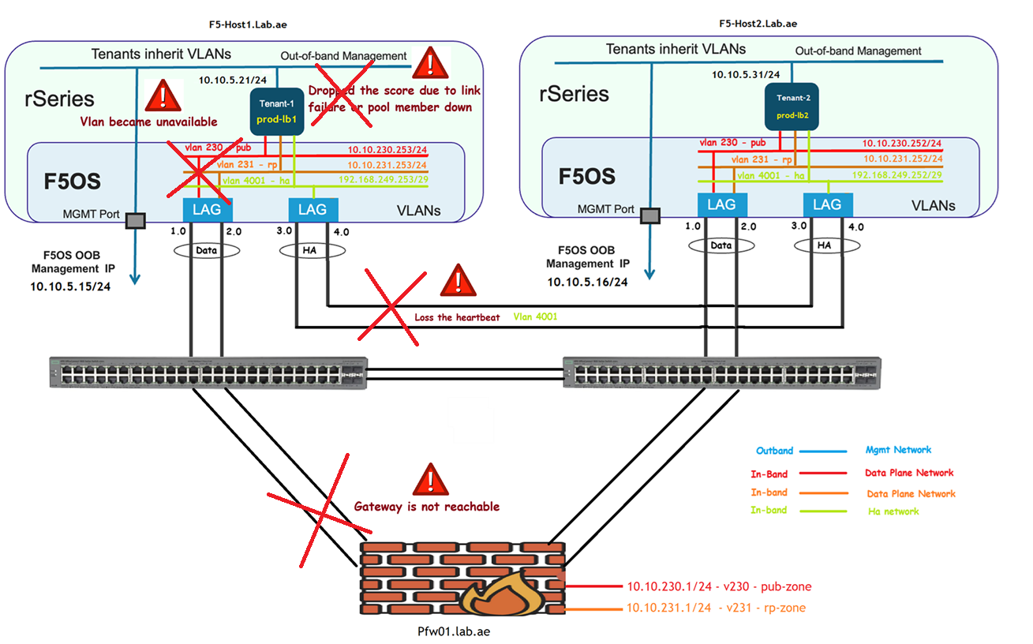
Chapter 8 – rSeries Tenant High Availability
Task 06 - F5 Device Service Clustering (DSC)
Section 01 - Let us understand Core Features of F5 DSC
Failover Mechanisms – When F5 Trigger the Failover from active unit to standby unit
Triggered by Peer Lost Heartbeat
Triggered by Loss of Gateway Reachability:
VLAN Failsafe Triggered:
Triggered by HA Group Health Score Change:
Any one of these conditions ensures rapid failover of traffic groups.

Slide 64
Chapter 8 – rSeries Tenant High Availability
Task 06 - F5 Device Service Clustering (DSC)
Section 02 - Let us verify DSC prerequisites
We should have at least two Big-ip devices to configure the DSC
Big-IP Device1 must be able to reach Big-IP Device2 through Management IP
Big-IP Devices must have matching software version
Big-IP devices must have proper licensing
Big-IP devices must have proper network connectivity

Slide 65
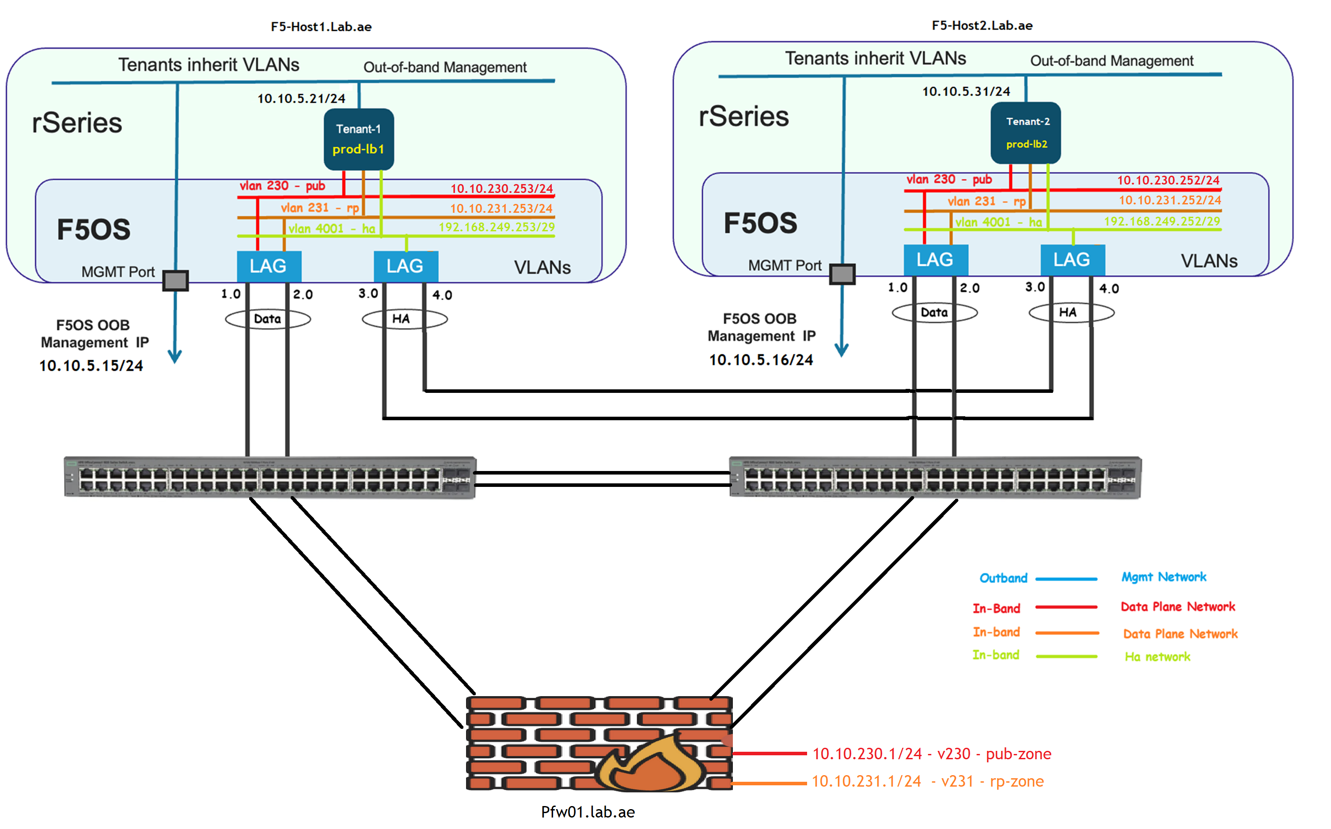
Chapter 8 – rSeries Tenant High Availability
Task 06 - F5 Device Service Clustering (DSC)
Section 02 - Let us verify DSC prerequisites
Let us verify Prerequisites: We should have two tenants
To build the HA - We should have at least two F5 BIG-IP devices.
Yes! We do have two tenants which is prod-lb1 & prod-lb2.

Slide 66
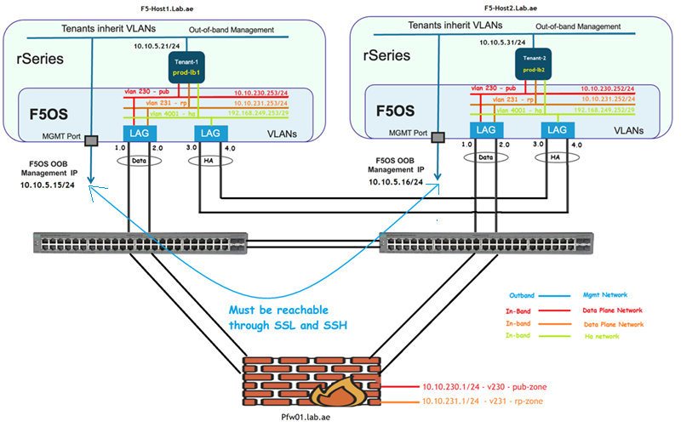
Chapter 8 – rSeries Tenant High Availability
Task 06 - F5 Device Service Clustering (DSC)
Section 02 - Let us verify DSC prerequisites
Let us verify Prerequisites: Device 1 must be able to reach Device 2 via its Management IP address on SSH & SSL
Management IPs on both devices must be reachable (through SSH and HTTPS) from each other.

Slide 67
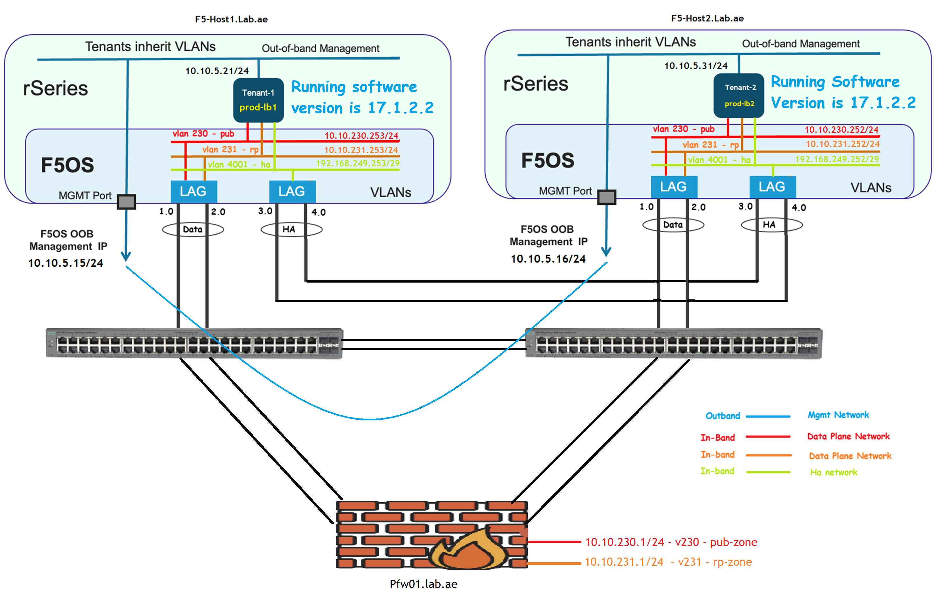
Chapter 8 – rSeries Tenant High Availability
Task 06 - F5 Device Service Clustering (DSC)
Section 02 - Let us verify DSC prerequisites
Let us verify Prerequisites: Devices must have matching software versions.
Let’s check the software version on prod-lb1:
Navigate to System > Configuration > Device > General
The running software version is BIG-IP 17.1.2.2
Let’s check the software version on prod-lb2:
Navigate to System > Configuration > Device > General
The running software version is BIG-IP 17.1.2.2

Slide 68
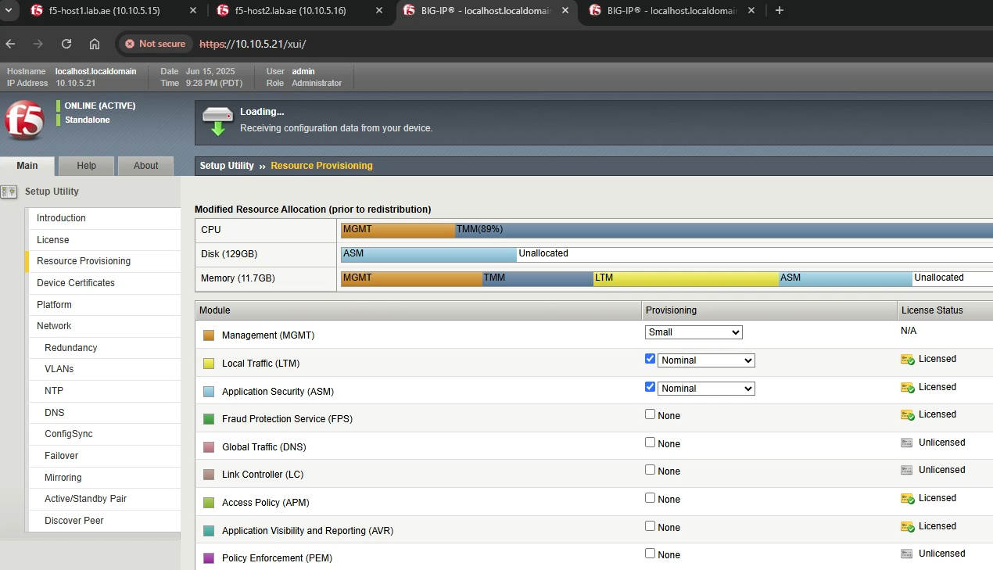
Chapter 8 – rSeries Tenant High Availability
Task 06 - F5 Device Service Clustering (DSC)
Section 02 - Let us verify DSC prerequisites
Let us verify Prerequisites: Devices must have proper licensing
Both devices inherit their licenses from the rSeries host and have identical license details, as shown in the diagram.
For this lab, we have activated the LTM and ASM modules on both tenants.

Slide 69
Chapter 8 – rSeries Tenant High Availability
Task 06 - F5 Device Service Clustering (DSC)
Section 02 - Let us verify DSC prerequisites
Let us verify Prerequisites: Big-IP devices must have proper network connectivity
Regarding HA network connectivity, it is a point-to-point LAG (Link Aggregation Group) between the rSeries appliances.
Additionally, VLAN 4001 has been created and associated with the HA Self IPs on both prod-lb1 (192.168.249.253) and prod-lb2 (192.168.249.253) to establish the tenant relationship.

Slide 70
Chapter 8 – rSeries Tenant High Availability
Task 06 - F5 Device Service Clustering (DSC)
Section 03 - Let us configure the DSC
Understand and Configure the Config Sync address
Understand and Configure the Network failover (Unicast & Multicast)
Understand and Configure the Connection Mirroring
Understand and Configure Device Trust & Device Trust Group
Understand datasync-global-dg & sync
Big-IP devices must have proper network connectivity

Slide 71
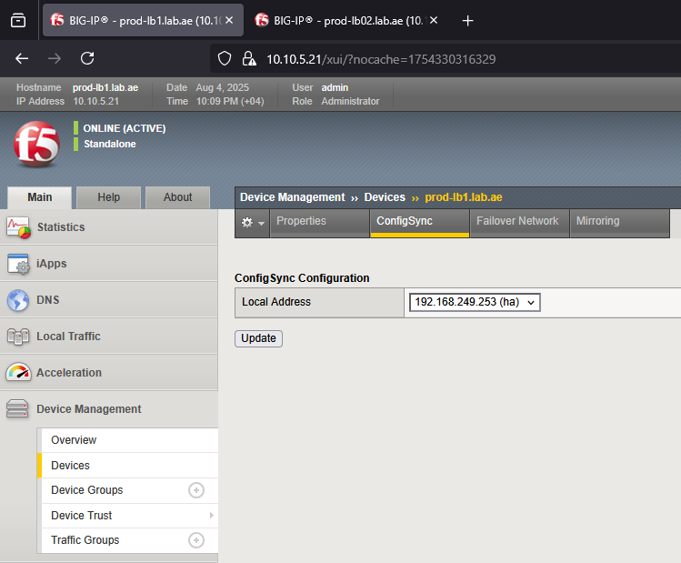
Chapter 8 – rSeries Tenant High Availability
Task 06 - F5 Device Service Clustering (DSC)
Section 03 - Let us configure the DSC
Let’s configure the HA prerequisites: Configure the Config Sync address
A Self IP address is required for configuration synchronization because it supports encrypted communication between BIG-IP devices.

Slide 72
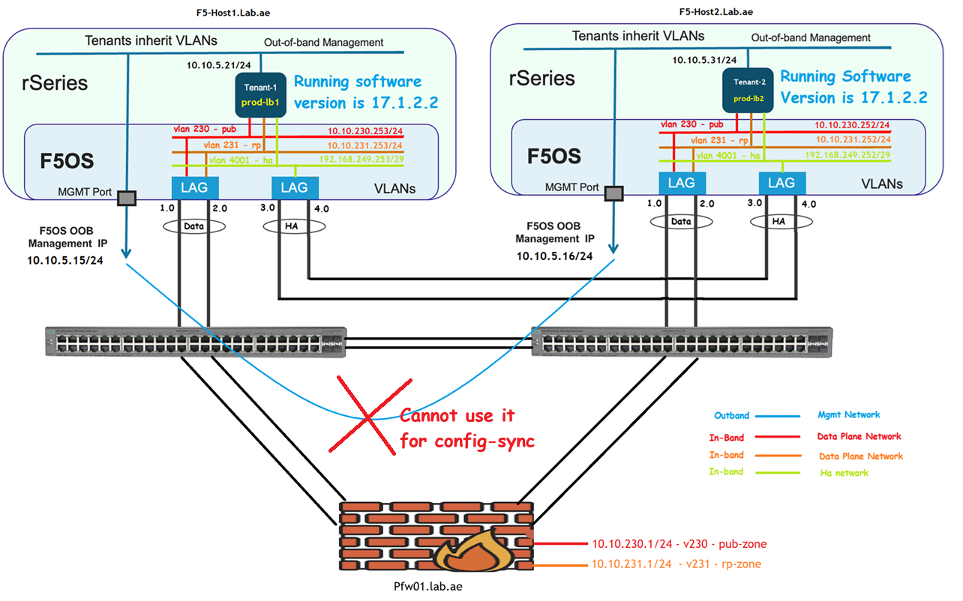
Chapter 8 – rSeries Tenant High Availability
Task 06 - F5 Device Service Clustering (DSC)
Section 03 - Let us configure the DSC
Let’s configure the HA prerequisites: Configure the Config Sync address
You cannot use the Management IP for config sync, as it does not support encrypted sync traffic. This is the reason you cannot see the manament ip addres not listed here.

Slide 73

Chapter 8 – rSeries Tenant High Availability
Task 06 - F5 Device Service Clustering (DSC)
Section 03 - Let us configure the DSC
Let’s configure the HA prerequisites: Configure the Config Sync address
As long as the selected Self IP is reachable from both devices and is configured to allow config sync traffic (TCP port 4353) via Port Lockdown settings, you can use one of the below:
  A Self IP from a client-side (external) VLAN
  A Self IP from a server-side (internal) VLAN (F5 recommended)
  The HA VLAN Self IP

Slide 74

Chapter 8 – rSeries Tenant High Availability
Task 06 - F5 Device Service Clustering (DSC)
Section 03 - Let us configure the DSC
Let’s configure the HA prerequisites: Configure the Config Sync address
In our case, we explicitly configure the local HA Self IP as the source for the configuration synchronization.

Slide 75
Chapter 8 – rSeries Tenant High Availability
Task 06 - F5 Device Service Clustering (DSC)
Section 03 - Let us configure the DSC
Let’s configure the HA prerequisites: Understand the network failover
It is the process where a device sends heartbeat messages over the network to ensure its peer is alive and reachable. If the heartbeat fails, the device assumes the peer is down and initiates a failover.
There are two types of network failover. Which is Unicast and Multicast
Unicast One-to-one communication. Heartbeat sent directly to peer’s IP.
🔸 For Unicast You define Local IP (your device Self IP)
🔸 F5 can discover the peer IP from incoming heartbeats.
Multicast One-to-many communication:
🔸 Heartbeat sent to multicast group address
🔸 If using more than two devices, consider multicast connectivity with IGMP support.
Point to point – Unicast Failover / Multicast is optional
Point to multipoint – Unicast and Multicast is recommended

Slide 76
Chapter 8 – rSeries Tenant High Availability
Task 06 - F5 Device Service Clustering (DSC)
Section 03 - Let us configure the DSC
Let’s configure the HA prerequisites: Which VLAN interface should we use as the unicast failover
The HA VLAN is specifically designed for device-to-device communication, such as:
  Heartbeats (unicast/multicast)
  Config sync
  Connection mirroring
Therefore, F5 strongly recommended to use the HA VLAN Self IP as the primary unicast failover source.
This ensures failover traffic is isolated from client/server application traffic, reducing the risk of failover messages being delayed or dropped due to congestion.
For additional failover communication paths, you can also: Use the Management Ips
This multi-path setup increases resilience in case one path becomes unavailable.

Slide 77

Chapter 8 – rSeries Tenant High Availability
Task 06 - F5 Device Service Clustering (DSC)
Section 03- Let us configure the DSC
Let’s configure the HA prerequisites: Which VLAN interface should we use as the unicast failover
We always use the F5 recommended path Which is HA vlan for the unicast failover

Slide 78
Chapter 8 – rSeries Tenant High Availability
Task 06 - F5 Device Service Clustering (DSC)
Section 03 - Let us configure the DSC
Let’s configure the HA prerequisites: Connection Mirroring
Time to Understand Connection Mirroring
Connection Mirroring is a stateful high availability feature in F5 BIG-IP.

Slide 79
Chapter 8 – rSeries Tenant High Availability
Task 06 - F5 Device Service Clustering (DSC)
Section 03 - Let us configure the DSC
Let’s configure the HA prerequisites: Connection Mirroring
It replicates active connection state information
  such as TCP session details,
  SSL handshakes, and
  SNAT translations
  from the active device to the standby device in real time.
This ensures that in the event of a failover, the standby unit can seamlessly continue processing existing connections without requiring clients to reconnect.

Slide 80
Chapter 8 – rSeries Tenant High Availability
Task 06 - F5 Device Service Clustering (DSC)
Section 03 - Let us configure the DSC
Let’s configure the HA prerequisites: Connection Mirroring
For connection mirroring, we will use the HA Self IP and We need to Allow-Custom TCP ports 1029–1155 for connection mirroring in port lock-down.

Slide 81

Chapter 8 – rSeries Tenant High Availability
Task 06 - F5 Device Service Clustering (DSC)
Section 03 - Let us configure the DSC
Let’s configure the HA: Device Trust
Device Trust is a secure relationship - established between two or more BIG-IP systems to allow them to:
Participate in high availability setups
We will use the management IP address to setup the device trust between prod-lb1 and prod-lb2

Slide 82
Chapter 8 – rSeries Tenant High Availability
Task 06 - F5 Device Service Clustering (DSC)
Section 03 - Let us configure the DSC
Let’s configure the HA: Device Trust as peer
Peer is typically recommended for 2-devices HA setup.
Use this when configuring a standard Active/Standby or Active/Active HA pair.
In this, Each device is typically added as a peer in the local trust domain and can sign certificates for the other if needed.

Slide 83
Chapter 8 – rSeries Tenant High Availability
Task 06 - F5 Device Service Clustering (DSC)
Section 02 - Let us configure the DSC
Let’s configure the HA: Device Trust as Subordinate
For larger deployments (more than two devices), consider the following approach:
Designate the first & second device as the peer in the local trust domain.
  Both devices will act as certificate authorities and can sign certificates for others.
  Add all remaining devices as subordinates.
  Subordinate devices cannot sign certificates;
  They rely on a certificate authority (which is our peers) to sign certificates for them.
reduces the overall attack surface and helps maintain a stronger trust boundary within the device group.
Peer
Peer
Subordinate
Subordinate

Slide 84

Chapter 8 – rSeries Tenant High Availability
Task 06 - F5 Device Service Clustering (DSC)
Section 03 - Let us configure the DSC
Let’s configure the HA: Device Trust Group
A Device Trust Group in F5 BIG-IP is a fundamental security framework that enables multiple BIG-IP devices to authenticate each other’s identity using digital certificates. This is the first step toward enabling high availability (HA), configuration synchronization, and failover between devices.
  Both the devices added to the device_trust_group and it is in sync.

Slide 85

Chapter 8 – rSeries Tenant High Availability
Task 06 - F5 Device Service Clustering (DSC)
Section 03 - Let us configure the DSC
Let’s configure the HA: datasync-global-dg
It also creates the datasync-global-dg device group and adds both devices to this group.
The datasync-global-dg device group is essential for BIG-IP ASM systems to operate correctly within the same trust domain.
Its primary purpose is to synchronize system client-side scripts and cryptographic keys across all devices in the trust domain.

Slide 86

Chapter 8 – rSeries Tenant High Availability
Task 06 - F5 Device Service Clustering (DSC)
Section 03 - Let us configure the DSC
Let’s configure the HA: Why are both BIG-IP devices showing as Active / In Sync?
Because there is no failover Group configured yet.
Without it, the traffic group roles (Active/Standby) are not elected,

Slide 87
Chapter 8 – rSeries Tenant High Availability
Task 06 - F5 Device Service Clustering (DSC)
Section 03 - Let us configure the DSC - Type of Device Groups
Two types of Device groups
  Sync-Only
  Sync-Failover Group

Slide 88
Chapter 8 – rSeries Tenant High Availability
Task 06 - F5 Device Service Clustering (DSC)
Section 03 - Let us configure the DSC - Sync-Only Failover Group
Sync-Only Failover Group is “Tie breaker” for traffic-group active-standby election.

Slide 89

Chapter 8 – rSeries Tenant High Availability
Task 06 - F5 Device Service Clustering (DSC)
Section 03 - Let us configure the DSC - Sync-Only Failover Group – Exchange Heartbeats over UDP/1026
Sync-Only Failover Group – Exchange Heartbeats over UDP/1026

Slide 90

Chapter 8 – rSeries Tenant High Availability
Task 06 - F5 Device Service Clustering (DSC)
Section 03 - Let us configure the DSC - Sync-Only Failover Group – (Split brain)
Navigate to Network → Self IPs → Create
Set the Name to : v4001-ha-self
Set the IP Address to : 192.168.249.252
Set the Netmask to : 255.255.255.248
Under VLAN/Tunnel, select : ha (which corresponds to VLAN 4001)
Set the port lockdown mode is set to : Allow-Custom
tcp:4353 – config sync
udp:1026 – network failover hear beats (blocked)
(It creates split brain)
Set the Traffic Group to : traffic-group-local-only

Slide 91

Chapter 8 – rSeries Tenant High Availability
Task 06 - F5 Device Service Clustering (DSC)
Section 03 - Let us configure the DSC – Preemptive
In our case the current active unit is prod-lb2.
But i wanted to keep prod-lb1 always active when it is available.
How can I achieve this?
Solution : Let’s Enable Pre-emptive Failover to achieve this!
This setting ensures that prod-lb1 always becomes the active unit whenever it's available.

Slide 92
Chapter 8 – rSeries Tenant High Availability
Task 07 - Validate HA Configuration Sync and Device Group Status
Configure the floating IP and sync to standby – Verify the config sync
Floating Self IPs are shared failover objects between BIG-IPs, passing data traffic to the respective ACTIVE BIG-IP.
To configure the Floating Self IP for client side and server side:

Slide 93
Chapter 8 – rSeries Tenant High Availability
Task 07 - Validate HA Configuration Sync and Device Group Status
Configure the Client Side and Server-Side Routes
🔹 Client Side is External - For our case it is Publishing VLAN (pub).
  This is where anyone can connect to us.
  So, we configure a default route to return responses to any client request.
🔸 Server Side is Internal - For our case it is Reverse Proxy VLAN (rp)
  This is where we connect to backend pool members using a SNAT IP from the server-side VLAN.
  Therefore, we configure the most specific route for the backend servers.

Slide 94
Chapter 8 – rSeries Tenant High Availability
Task 07 - Validate HA Configuration Sync and Device Group Status
Let’s Verify Some Common HA Status from the CLI
🔹 To check device trust and group membership, type:
tmsh show cm device
You should see two devices in the trust and sync-failover group, with their roles (active/standby) displayed.
🔹 To check device group sync status, type:
tmsh show cm sync-status
This shows whether the peer is connected and in sync, or if there are configuration changes pending.
🔹 To check when the last failover occurred, type:
tmsh show sys failover
In our case, we triggered it manually during configuration when we enabled preemptive mode.
🔹 To troubleshoot live failover events, type:
tail -f /var/log/ltm | grep -i failover
This shows real-time failover events and helps with troubleshooting.

Slide 95

✅ This ends up our discussion on HA Design, Implementation, and Testing.
📘 We’re now done with the rSeries learning.
📺 I’ll catch you all in the next series, which will be focused on LTM learning.
Thank you for watching!

